Slide 1
Rich Text Formatting in Maximo
Scott Dickerson
scottsd@us.ibm.com
UI Framework Designer

Slide 2
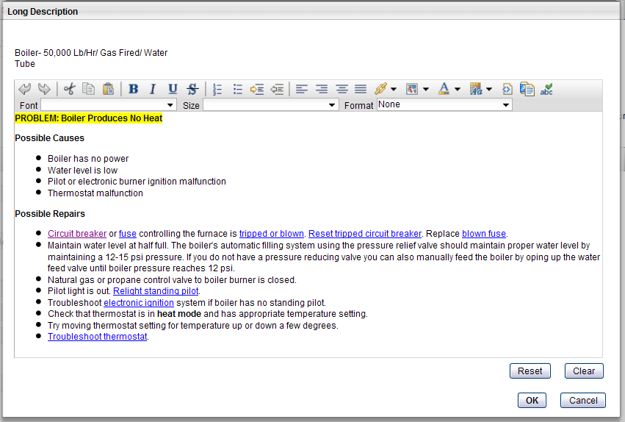
What is rich text formatting?
New widget available in Maximo Asset Management 7.5 and SmartCloud Control Desk 7.5
Flexible Fonts
Bold, Italics, Underline, etc.
Character Sizes
Bullets
Colors and Highlighting
URL links
Supports copy/paste from Word, etc.

Slide 3
Using Rich Text in the UI
Users can enter text in the format that they want on a Maximo screen
You no longer need to rely on attachments to show rich text to your end users
Available out of the box:
Maximo
All Long Descriptions, Communication Templates, Communication History, and Work Logs,
Bulletin Board Messages
Solutions application: Problem, Cause and Resolution fields.
Create Service Request, View Service Request
Configuration Item
SCCD
Service Catalog Offerings application description and additional details section.
Inline Ticket Details and Workorder Details (Long Descriptions)

Slide 4
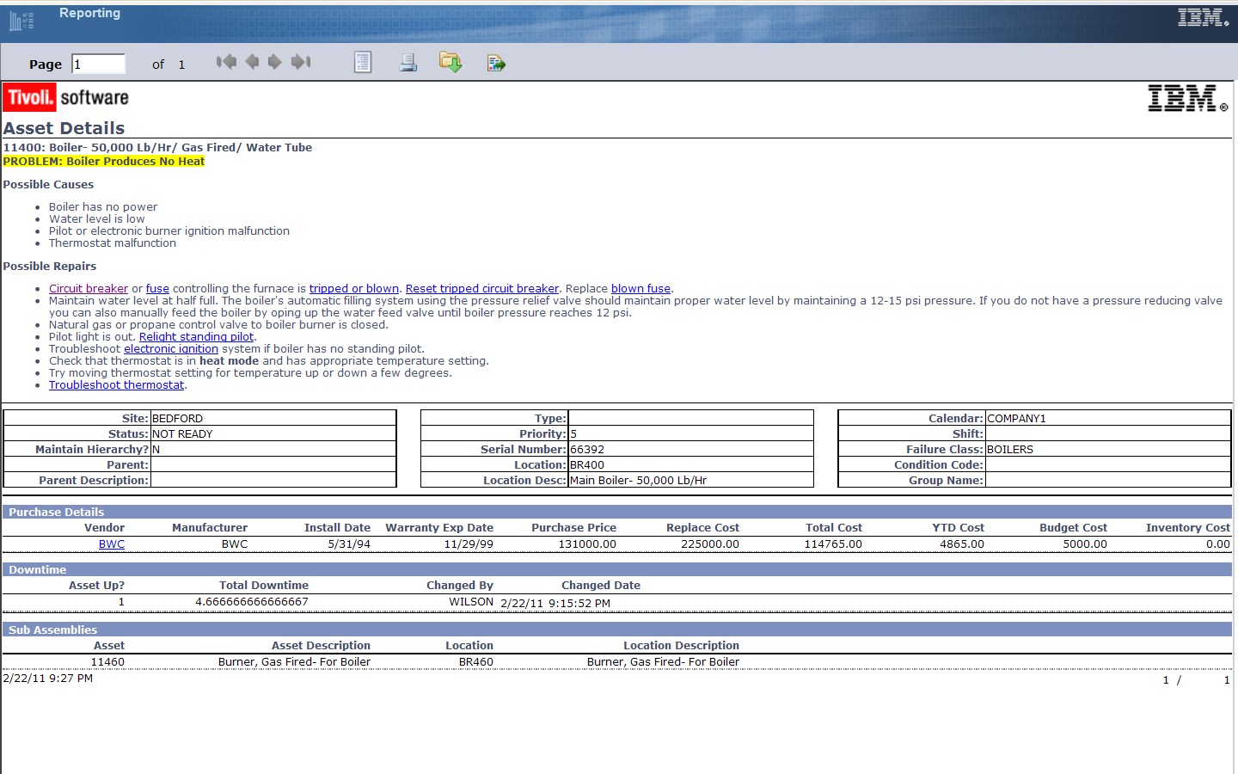
Displaying Rich Text in Reports
Enabled Rich Text Formats to display in BIRT Reports

Slide 5
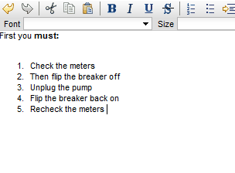
Rich Text Formatting in the Database
Rich Text formatting XML tags are directly stored in the database
Widget
Database

Slide 6
After upgrade
Rich text widgets are added to the User Interface
Replacing Multiline text box widgets in some cases in Maximo
Replacing a previous version of the Rich text widget in SCCD
Existing data is not upgraded to have rich text content
You must run update updateRichText.bat
http://www-01.ibm.com/support/docview.wss?uid=swg21590089
All out-of-the-box reports are updated to support rich text for the fields enabled out of the box
Custom reports must be updated manually to support rich-text
https://www.ibm.com/developerworks/community/blogs/a9ba1efe-b731-4317-9724-a181d6155e3a/entry/bilog_75_reporting_with_rtf_rich_text_formatting_or_reporting_to_the_fullest7?lang=en

Slide 7
Integration with Rich Text
Rich Text Formatted data is exported through the Integration layer
You will need to process and strip the rich text out if your Integration layer cannot handle it
Because of this, some clients are turning off the rich text functionality.
https://www.ibm.com/developerworks/community/wikis/home?lang=en#/wiki/IBM%20Maximo%20Asset%20Management/page/Making%20long%20description%20a%20text%20field
There are enhancement requests in our backlog to make this configurable in the product, please vote for them
http://www.ibm.com/developerworks/rfe/execute?use_case=viewRfe&CR_ID=28405

Slide 8
Integration with Rich Text
You can implement a java outbound processing class in your Object Structure or user exit to strip out the tags
The object structure definition class file must be:
Compiled
Included in the application EAR file (rebuild and re-deploy EAR file)
Registered on the applicable Object Structure

Slide 9
Sample Object Structure Outbound Processing Class

Slide 10
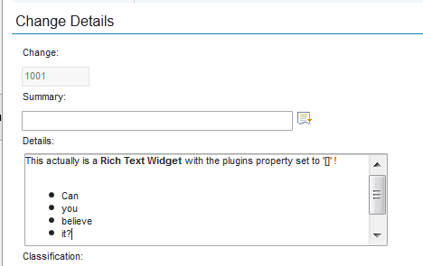
Configuring the Rich Text Widget
There are actually two rich-text enabled widgets:
<richtextviewer>
<richtexteditor>
Turn off the “markup” bar by editing the plugins property
http://pic.dhe.ibm.com/infocenter/tivihelp/v50r1/topic/com.ibm.mbs.doc/designer/r_props_rich_text_editor.html

Slide 11
Preserving CRs using Email Listener
The message body of the email is written directly to the ticket long description field (as well as the commlog msgbody field).
This is fine if the body of the email is of content-type=text/html as the RTE renders it just fine.
If the content-type is text/plain, the RTE flattens the text as it does not recognize whitespace control characters.
If your mail server sends the content as text/plain, you can use this workaround to Preserve CRs:
https://www.ibm.com/developerworks/community/blogs/a9ba1efe-b731-4317-9724-a181d6155e3a/entry/a_maximo_scripting_solution_to_a_plain_text_problem?lang=en

