Slide 1
Welcome to IBM SouthBank, London
Maximo UK and Ireland User Group
14th November 2019

Slide 2
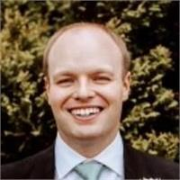
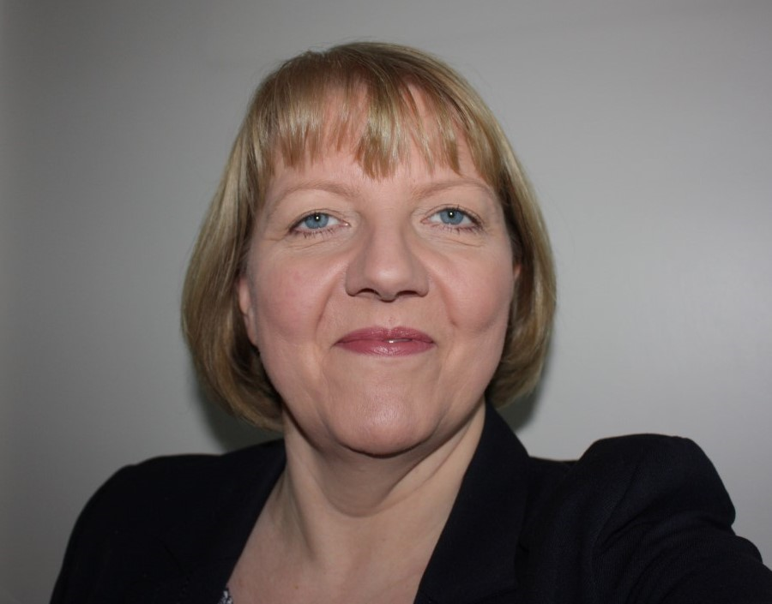
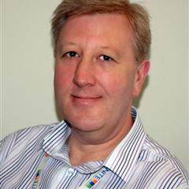
Kenny McAneaney
Linda Wilkinson
Peter Philip
Welcome to our new committee members!

Slide 3
A word of thanks to our sponsors

Slide 4
14th November Agenda,
London
Registration including tea/coffee | 08.15
Introduction | 09.00
Maximo 7.6 Roadmap – Pam Denny, IBM | 09.20
Maximo Global Roll Out – Data - Andreas Diamanti, Swissport | 09.50
Upgrade to 7.6 and Fingertip– Kenny McAneaney, NIE | 10.10
Introduction from sponsors | 10.30
Break | 10.45
Navigating the Digital Hype – James Cooper, AMCL | 11.15
Table topics - see next page for specific details | 11.35
Lunch | 12.40
Table topics continued | 13.40
MUG Community Update – Sarah-Jane Cogley, IBM | 15.05
Table topics feedback | 15.20
Wrap up | 15.50
Close | 16.00
Notes:
Gathering the feedback to be done at lunch

Slide 5
Interactive Table Topics
Topics | Name & Company
7.6 Roadmap inc Maximo Anywhere | Pam Denny, IBM
Upgrade to 7.6 and Fingertip | Kenny McAneaney, NIE
Maximo Global Roll Out - Data | Andreas Diamanti, Swissport
Navigating the Digital Hype | James Cooper, AMCL
‘Tech of the future’ | IBM/Samsung

Slide 6
20:00
Minutes left

Slide 7
19:00
Minutes left

Slide 8
18:00
Minutes left

Slide 9
17:00
Minutes left

Slide 10
16:00
Minutes left

Slide 11
15:00
Minutes left

Slide 12
14:00
Minutes left

Slide 13
13:00
Minutes left

Slide 14
12:00
Minutes left

Slide 15
11:00
Minutes left

Slide 16
10:00
Minutes left

Slide 17
9:00
Minutes left

Slide 18
8:00
Minutes left

Slide 19
7:00
Minutes left

Slide 20
6:00
Minutes left

Slide 21
5:00
Minutes left

Slide 22
4:00
Minutes left

Slide 23
3:00
Minutes left

Slide 24
2:00
Minutes left

Slide 25
1:00
Minute left

Slide 26
Time is up!

Slide 27
20:00
Minutes left

Slide 28
19:00
Minutes left

Slide 29
18:00
Minutes left

Slide 30
17:00
Minutes left

Slide 31
16:00
Minutes left

Slide 32
15:00
Minutes left

Slide 33
14:00
Minutes left

Slide 34
13:00
Minutes left

Slide 35
12:00
Minutes left

Slide 36
11:00
Minutes left

Slide 37
10:00
Minutes left

Slide 38
9:00
Minutes left

Slide 39
8:00
Minutes left

Slide 40
7:00
Minutes left

Slide 41
6:00
Minutes left

Slide 42
5:00
Minutes left

Slide 43
4:00
Minutes left

Slide 44
3:00
Minutes left

Slide 45
2:00
Minutes left

Slide 46
1:00
Minute left

Slide 47
Time is up!

Slide 48
20:00
Minutes left

Slide 49
19:00
Minutes left

Slide 50
18:00
Minutes left

Slide 51
17:00
Minutes left

Slide 52
16:00
Minutes left

Slide 53
15:00
Minutes left

Slide 54
14:00
Minutes left

Slide 55
13:00
Minutes left

Slide 56
12:00
Minutes left

Slide 57
11:00
Minutes left

Slide 58
10:00
Minutes left

Slide 59
9:00
Minutes left

Slide 60
8:00
Minutes left

Slide 61
7:00
Minutes left

Slide 62
6:00
Minutes left

Slide 63
5:00
Minutes left

Slide 64
4:00
Minutes left

Slide 65
3:00
Minutes left

Slide 66
2:00
Minutes left

Slide 67
1:00
Minute left

Slide 68
Time is up!

Slide 69
20:00
Minutes left

Slide 70
19:00
Minutes left

Slide 71
18:00
Minutes left

Slide 72
17:00
Minutes left

Slide 73
16:00
Minutes left

Slide 74
15:00
Minutes left

Slide 75
14:00
Minutes left

Slide 76
13:00
Minutes left

Slide 77
12:00
Minutes left

Slide 78
11:00
Minutes left

Slide 79
10:00
Minutes left

Slide 80
9:00
Minutes left

Slide 81
8:00
Minutes left

Slide 82
7:00
Minutes left

Slide 83
6:00
Minutes left

Slide 84
5:00
Minutes left

Slide 85
4:00
Minutes left

Slide 86
3:00
Minutes left

Slide 87
2:00
Minutes left

Slide 88
1:00
Minute left

Slide 89
Time is up!

Slide 90
20:00
Minutes left

Slide 91
19:00
Minutes left

Slide 92
18:00
Minutes left

Slide 93
17:00
Minutes left

Slide 94
16:00
Minutes left

Slide 95
15:00
Minutes left

Slide 96
14:00
Minutes left

Slide 97
13:00
Minutes left

Slide 98
12:00
Minutes left

Slide 99
11:00
Minutes left

Slide 100
10:00
Minutes left

Slide 101
9:00
Minutes left

Slide 102
8:00
Minutes left

Slide 103
7:00
Minutes left

Slide 104
6:00
Minutes left

Slide 105
5:00
Minutes left

Slide 106
4:00
Minutes left

Slide 107
3:00
Minutes left

Slide 108
2:00
Minutes left

Slide 109
1:00
Minute left

Slide 110
Time is up!

Slide 111
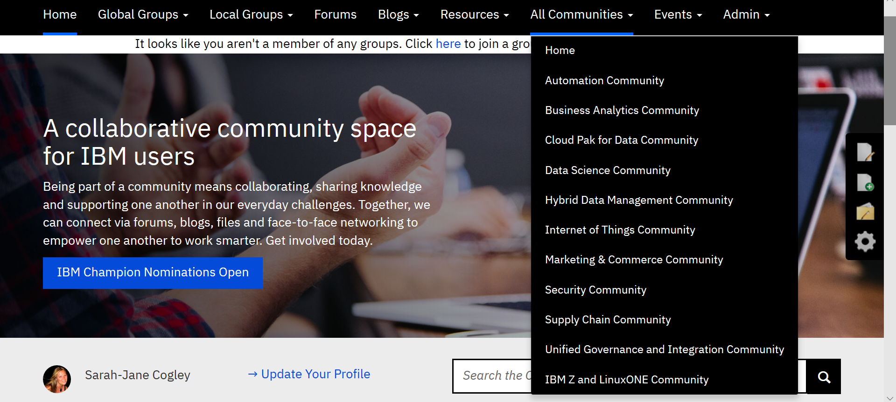
IBM Community
Notes:
The IBM Community now has 12 communities

Slide 112
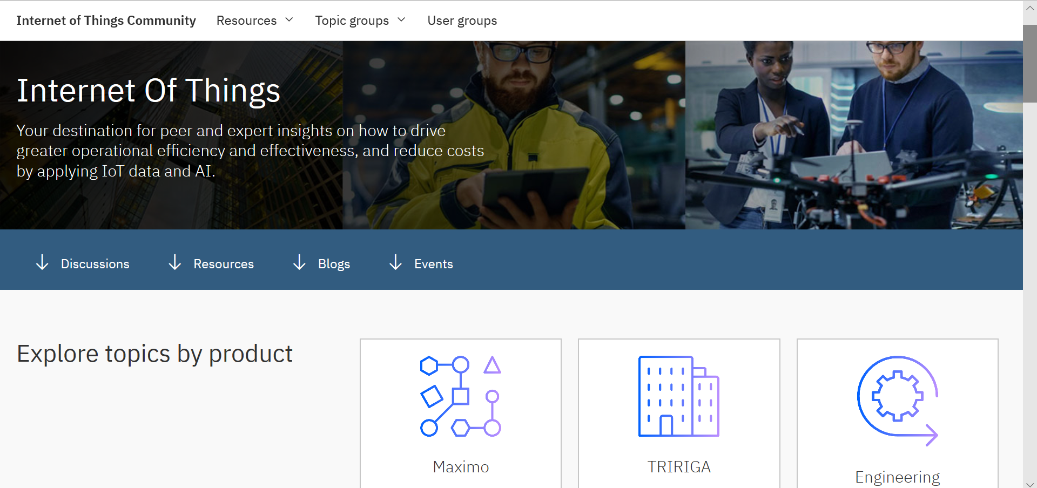
Internet of Things Community
Notes:
Internet Things community is now has it’s own community page

Slide 113
130,000+
MEMBERS AND COUNTING
ACROSS
MEMBERSHIP
56
COUNTRIES
11
COMMUNITIES
Notes:
The IBM Community has 130.000 +members in 56 countries.

Slide 114
WELCOME TO YOUR
USER GROUP
DISCUSSIONS
LIBRARY
The Discussion forums are a great venue to ask questions of your peers and IBM subject matter experts to share best practices, pitfalls to avoid, and to learn from each other.
The Library is the place to find all of the group's discussion post attachments, file uploads, and other resources that will help you learn and build your skills.
BLOGS
Read about the latest features and functionality of your solution from our top subject matter experts and experienced product users.

Slide 115
FIND A GROUP
GET ANSWERS TO YOUR QUESTIONS
CONNECT WITH PEERS
SHARE YOUR EXPERTISE
WHY SHOULD I JOIN THE COMMUNITY?
WEBINARS
Events
8 live webcasts each month and
access to hundreds of
on-demand replays
In person events from New York
to Japan
Virtual Community days

Slide 116
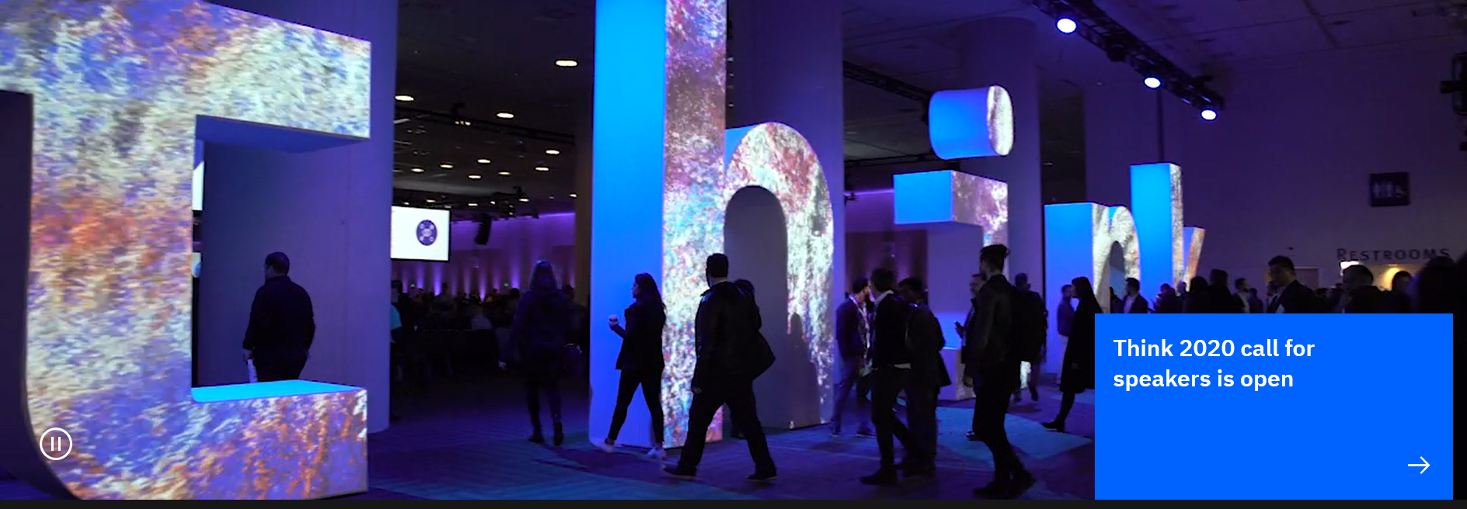

Slide 117
Interactive Table Topics - FEEDBACK
Topics | Name & Company
7.6 Roadmap inc Maximo Anywhere | Pam Denny, IBM
Upgrade to 7.6 and Fingertip | Kenny McAneaney, NIE
Maximo Global Roll Out - Data | Andreas Diamanti, Swissport
Navigating the Digital Hype | James Cooper, AMCL
‘Tech of the future’ | IBM/Samsung

Slide 118
A date for your diaries!
Next meeting May 2020 ……………..!!
Another big thank you to our sponsors, presenters and SME’s

