Slide 1
z/Now! Resources for Developing Open Source Software for Linux on IBM Z and LinuxONE
Elizabeth K. Joseph, Developer Advocate
@pleia2
13 January 2022

Slide 2
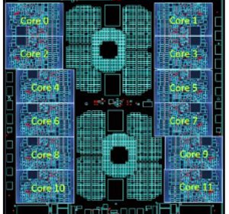
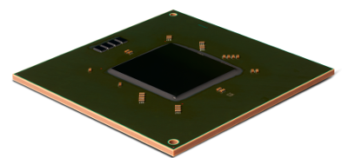
IBM Z / s390x / zArchitecture
190 5.2ghz processor units (PUs), with 12 cores per chip
But also...
40TB of RAM
60 PCIe control units across 12 PCIe I/O drawers
22 dedicated I/O offload processors (SAPs) pre-allocated per system

Slide 3
Upcoming: Telum Processor
"IBM Telum Processor: the next-gen microprocessor for IBM Z and IBM LinuxONE" https://www.ibm.com/blogs/systems/ibm-telum-processor-the-next-gen-microprocessor-for-ibm-z-and-ibm-linuxone/
Terminal Talk: "Christian Jacobi tells us all about Telum" https://www.terminaltalk.net/e/christian-jacobi-tells-us-all-about-telum/

Slide 4
Linux on IBM Z
Started out as the "Bigfoot" (i370) port by several community members in 1998-99.
IBM released the first Linux kernel patches to support s390x in December 1999.
In October 2000, SUSE Linux Enterprise Server (SLES) became the first, still in production, enterprise Linux to support s390x.
Red Hat Enterprise Linux (RHEL) quickly followed as the second, still in production, enterprise Linux for the mainframe.
Ubuntu support was announced in 2016 and began with Ubuntu 16.04.

Slide 5
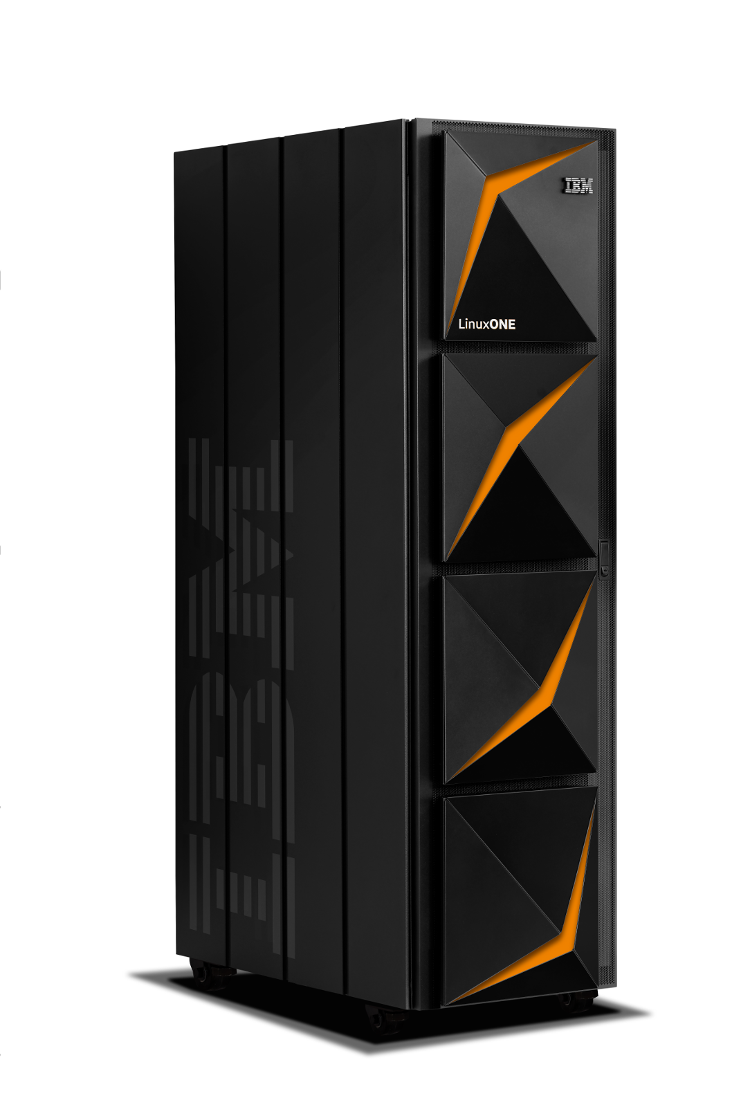
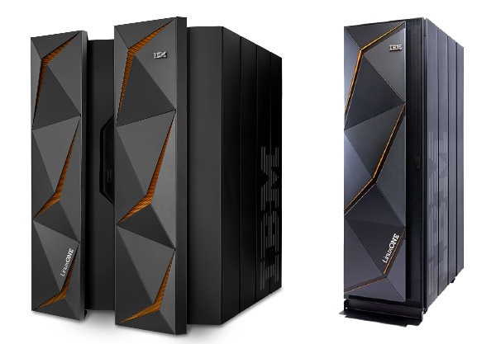
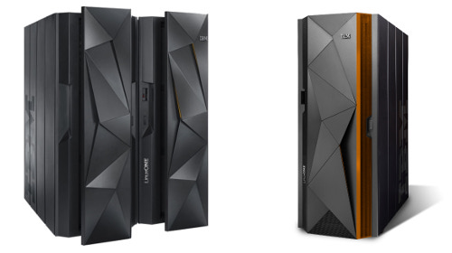
Linux Today
Announced at the Linux Foundation’s LinuxCon 2015, IBM released the first Linux-only mainframe, the IBM LinuxONE.
Today’s LinuxONE is in its third iteration, with the LinuxONE III released in September 2019.
2015: LinuxONE Emperor & Rockhopper
2017: LinuxONE Emperor II & Rockhopper II
2019: LinuxONE III

Slide 6
IBM Z has an open source legacy!
In 1955, the volunteer-run SHARE Inc was founded.
A key resource for this organization was the SHARE library of software that systems programmers would share among their peers, freely.
In 1959, SHARE released the SHARE Operating System (SOS), one of the first true "operating systems"¹ and Wikipedia says of SOS:
"SOS was one of the first instances of "commons-based peer production" now widely used in the development of free and open-source software such as Linux and the GNU project."
¹ https://en.wikipedia.org/wiki/SHARE_(computing)

Slide 7
Are other projects porting their apps? Yes!

Slide 8
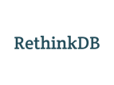
Linux Distributions & Virtualization
Cloud & Container Services
Languages & Runtimes
DevOps/Automation
Big Data, Observability, Analytics
Community Versions
Databases
ClefOS
Middleware
Networking & Monitoring
www.ibm.com/community/z/open-source-software/
Notes:
- We have a large and growing ecosystem of open source software for IBM Z & LinuxONE
- This slide represents only a partial list of all the open source software available in IBM Z & LinuxONE
- No different to other processor architectures like ARM or x86, software for IBM Z & LinuxONE also known as s390x requires Linux distribution compiled in the corresponding processor architecture.
- We have a team of IBM upstream engineers that are constantly porting and validating new versions of open source software or adding new open source software.
- Outside IBM the open source community has ported and validated hundreds of open source software for s390x.
- This open source software for s390x, is available in GitHub, individual software distribution sites or in Docker Hub.
* ClefOS (the goose), it is an open source Linux distribution for Z based on RHEL/CentOS

Slide 9
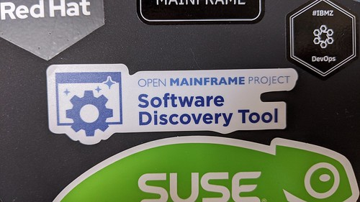
Finding Open Source Software for Linux
Search distributions with the Open Mainframe Project Software Discovery Tool https://www.openmainframeproject.org/projects/software-discovery-tool
Browse the IBM Z and LinuxONE Container Registry https://ibm.github.io/ibm-z-oss-hub/main/main.html
Go directly to the project, do they have s390x builds?
Ask your vendor, is there a port they maintain?

Slide 10
Full project hosting, including code, and mailing lists
Blogs and podcasts of general interest to the open source mainframe community
Slack and forums for communication among participants
Project support for 3rd party open source projects seeking infrastructure (VMs, CI/CD services)
Annual conference!

Slide 11
IBM LinuxONE Community Cloud
"The IBM LinuxONE Community Cloud is a no-charge, 24 x 7, enterprise-grade, open access, shared public cloud environment on IBM's LinuxONE platform. Developers, students, professors, entrepreneurs, or anyone from all over the world can sign up for 120-day access to a virtual server with full access to develop, test, or run open source applications on LinuxONE, or to access any of the other services offered."
Visit https://developer.ibm.com/linuxone to get started
And join the LinuxONE Community Cloud Community at https://www.ibm.com/community/z/linuxone-cc/

Slide 12
Ubuntu Personal Package Archives (PPAs) on Launchpad.net Documentation: https://help.launchpad.net/Packaging/PPA

Slide 13
openSUSE build service at build.opensuse.org

Slide 14
Jenkins instance for s390x maintained by the Oregon State University Open Source Lab (OSU OSL)
https://osuosl.org/services/ibm-z/

Slide 15
TravisCI build service for s390x (Beta trial for open source projects)
Documentation: https://docs.travis-ci.com/user/multi-cpu-architectures/

Slide 16
So, any programming language?

Slide 17
Programming Language Tips
Source code across architectures will generally be identical, but it needs to be compiled (C, C++), or otherwise interpreted (Python, Node.js) for this architecture.
That means you need a compiler or an interpreter built for the mainframe.
The mainframe architecture is big-endian, but most of the supported architectures today are little-endian.
Your code will probably build and run, give it a try!
If not, note that the higher level a language is, the more luck you'll have. Lower level languages like C do more hardware-specific operations, higher level languages like Node.js have much of that abstracted away.

Slide 18
Questions?
Elizabeth K. Joseph
lyz@ibm.com
@pleia2
Join us in the IBM Z Community: https://www.ibm.com/community/z/open-source/

