Slide 1
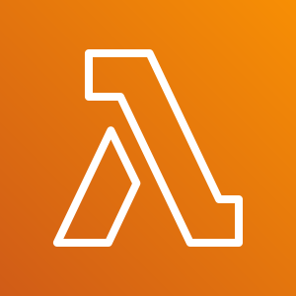
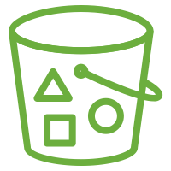
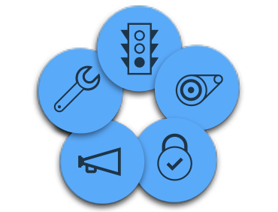
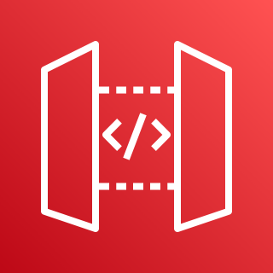
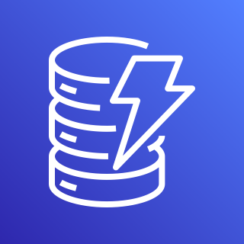
One of my colleague and Senior Maximo consultant said Maximo is so flexible we can call it ‘Fleximo’ – I agree with him. Having said that the flexibility is leading us into complex Integration architecture. Bigger problem is that the same architecture cannot be used for future clients, most of the time. There will be learning but the new project means new Integration design.
MIF customization features will never go out of Maximo implementations and a lot of customers will continue to use them but it’s time we( Maximo Consultant) start designing reusable Maximo integrations architecture. Here Below is a Simple architecture which can be adopted by any project and I believe there will be a number of use cases which will fit to this architecture. I have used AWS services, but similar services are present in all the leading cloud platforms:
AWS Cloud
External System
Components Used:
API Gateway : Get and post Data into AWS
AWS Lambda: Easy to configure and code AWS function for Data transformation and storage
AWS S3: File based Raw data Storage in AWS used as a data lake
AWS DynamoDB: NoSQL DB
AWS Kinesis: Data Streaming service
AWS Lambda
Amazon S3 output bucket
Amazon API Gateway
Amazon API Gateway
Amazon Kinesis
AWS Lambda
AWS Lambda
Maximo
Amazon DynamoDB
Benefits of this Architecture( not limited to this)
Some Use Cases:
More and more customer are moving embarking their cloud journey and I believe this will streamline their cloud investment.
Same Architecture for all the projects. Maximo Publishes or Reads data from Cloud platform solution.
No or minimal dependency on external system /middleware team( if the external system still relies on it)
Technical resources do not have to re-learn new things in each project. As an organization , it would have technical resources who can be fit into other project requiring similar skills and vice-versa.
The amount ifs, buts and design question marks will be minimal. It will work the same in all the projects.
One Important criteria and this is always missed in the Maximo Integration projects, Testing team can view the data generated from source and destination system and perform better testing rather than depending on developers to share the generated xml or json or flat file. IAM roles can be created for testing team.
Better insights, Business intelligence and data analysis when the data is stored in data lake.
Serverless ETL – No complex enterprise middle products and skillsets specific to the middleware product is required. Rather a good Maximo technical resource can do the ETL for client.
No need to learn new programming languages to do this data transformation. All the major languages are supported.
Better tracking and reverting to old data with the help of efficient cloud data engineering solution.
Less Data replication and duplication as this kind of architecture helps to achieve on-demand data post and fetch
Exchange Rates Integration
Vendor catalogue Item and cost Integration.
Inventory transactions and reconciliation Integration
Vendor Invoice Integration
Alignment of procurement process with Finance System
Asset Meter reading data
Weather Data Integration – Event based triggers
ETL for Data Migration, Analysis and Intelligence
IOT device data Integration
Important Note This is just an initial thought and I believe it can be designed in N number of ways with more experience in Cloud Data Engineering pipelines

