Slide 1
How and why to archive & purge application data?
Tech overview about Optim archive & purge process

Slide 2
Agenda
About HCA
Our ERP environment
Why we needed a data archive strategy?
What is Optim archive?
How did we archive & purge?
Limitations in using Optim archive tool
Lessons learnt & best practices
Q&A

Slide 3
About HCA
HCA Healthcare
HCA is named one of the world’s most ethical companies for nine years in a row.
180+ hospitals and 2000+ sites of care (including surgery centers, freestanding ERs, urgent care centers, and physician clinics) in 21 states and the United Kingdom.
Ranked 64th in Fortune 500.
280,000 employees
38,000+ active physicians
90,000+ nurses
5,300+ IT employees
- 28 million patient encounters per year
8.6 million emergency visits per year
Notes:
HCA Healthcare is an American for-profit operator of health care facilities that was founded in 1968. It is based in Nashville, Tennessee.

Slide 4
Our ERP environment
Enterprise Resource Planning (ERP) environment:
- 85 databases supporting ERP development, QA and Prod
Financials
- 2500+ tablespaces & 7500 indexes per database
HR
Payroll
- Largest table is in Payroll and it has 1.5+ billion rows and 7 Indexes
ERP
System
Resource Planning
Supply Chain
Notes:
We use Lawson ERP software from Infor.

Slide 5
Why we needed a data archive strategy?
App usage growth
Retention policies
Tiresome DBA tasks
Vendor limitations
Notes:
App usage growth - HCA buys new facilities frequently. With every new purchase the volume of data in ERP application increases.
Retention policies - Legally, we have to maintain at least 7 years data for HR & Payroll. But, there was data 15 years of data in the prod databases.
Tiresome DBA tasks - regular DBA maintenance tasks like reorgs have become difficult to complete due to no data purge policy.
Vendor limitations - ERP application has no data purge capability built into it. So, we have to come up with a solution for data archive and purge.

Slide 6
What is Optim archive?
IBM InfoSphere Optim Data Growth Solution for z/OS provides everything you need to create and manage archives of relationally intact data from databases with any number of tables and relationships. Using the archiving features in Optim Data Growth Solution for z/OS, you can:
Isolate historical data from current activity and safely remove it to a secure archive.
Access archived historical data easily, using familiar tools and interfaces.
Restore archived data to its original business context when it requires additional processing.
Build repetitive process which can be executed whenever needed.
Notes:
The thing I like most about Optim Archive product is it provides various approaches for archiving the data.
Lets see some approaches in the coming slides.

Slide 7
Design 1
Mainframes
1
Archive
1
Optim
2
Purge
Prod operational database
2
2
1
Archive File
ODBC/JDBC Reporting Tools
ODM
Notes:
Archive file is a sequential dataset.
Open Data Manager (ODM) allows third-party applications to access Optim archived data through ODBC/JDBC.

Slide 8
Design 2
Mainframes
1
Archive
1
Optim
2
2
Restore
Prod operational database
Archive Database
3
Purge
3
4
Create FTP file
3
1
2
4
FTP file
Archive File
ODM
ODBC/JDBC Reporting Tools
Cloud or Hadoop

Slide 9
Design 3
Mainframes
DB2LUW/Oracle/SQLServer
1
Archive
1
Optim
2
Restore
2
Prod operational database
Archive Database
3
Purge
3
3
1
2
Archive File
ODM
ODBC/JDBC Reporting Tools

Slide 10
How did we archive & purge?
Choosing the suitable archive design
Creating Access Definitions (AD) and relationships
Build and execute JCLs

Slide 11
1. Choosing the suitable archive design
Mainframes
1
Archive
Prod operational database
Archive database
Restore
1
Optim
2
3
Purge
2
4
3
4
4
Reorg
3
1
2
Archive File
Notes:
Reorg JCLs are not generated by Optim.
We didn’t use any reporting tools on the archive database, as there was no business need for that.

Slide 12
2. Creating Access Definitions (AD) and relationships
An Access Definition describes the data to be extracted from the source database.
The components of an Access Definition include the following:
A list of tables from which the data is extracted.
Selection criteria (WHERE clause in SQL query).
- The list of relationships to be traversed.
Notes:
We archived data from 26 tables for HR and 56 tables for Payroll.

Slide 13
3. Building and executing JCLs
Once the AD and relationships are defined, Optim tool provides the capabilities to build the archive & purge JCLs.
Those JCLs can be saved into your own PDS members and execute them as per the schedule plan.

Slide 14
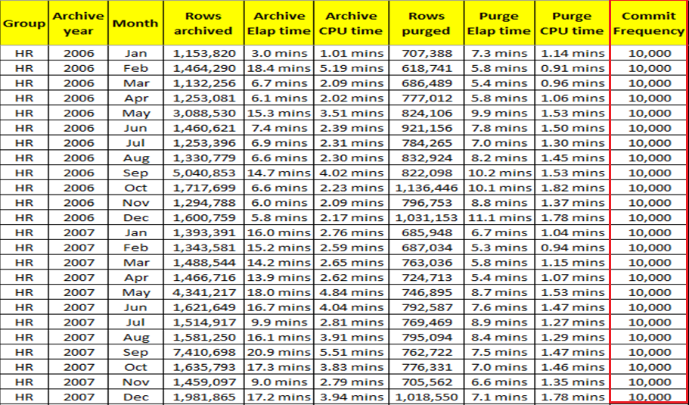
Just some stats to wow you!!!

Slide 15
Limitations in using Optim archive tool
Run SQL query
SQL query
1
1
RFE#OPTIM-I-126
1
2
Archive
Prod operational database
Archive database
Db2 table
3
Restore
5
2
5
4
Purge
2
Optim
5
Reorg
4
3
4
2
3
Archive File
Notes:
There is a feature available in Optim called “Optim Archive Actions”, which allows you to define actions to be executed at predefined points during an Archive, Delete, or Restore Process.
But, this feature was not addressing our requirement completely.

Slide 16
Lessons learnt & best practices
Unload jobs Vs Insert jobs
Try to break the jobs.
Notes:
Let me share a personal story here.

