Slide 1
How to Limit Cloud Cost Waste with FinOps Accountability and Automation — Flexera One with IBM Observability and IBM Turbonomic Application Resource Management

Slide 2
Agenda
FinOps Overview
Aligning Finance and Engineering
How Flexera One with IBM Observability and IBM Turbonomic can help
Demos
Wrap up with Q&A
Lee Ditiangkin
IBM Automation Product Management, IBM, FinOps Board Member
Brian Adler
Sr. Director, Cloud Market Strategy, Flexera, FinOps Board Member
AJ Nish
Head of Product, IBM Turbonomic ARM
Josh Fraser
Global Lead & VP, Solution Engineering and Executive Advisory

Slide 3
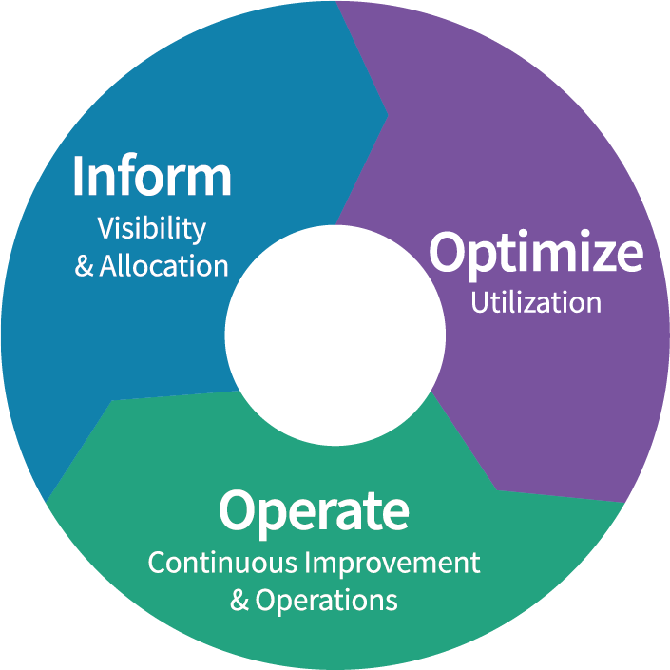
FinOps is an evolving cloud financial management discipline and cultural practice that enables organizations to get maximum business value by helping engineering, finance, technology and business teams to collaborate on data-driven spending decisions. - FinOps Foundation Technical Advisory Council
FinOps Framework Phases
Any company may be in multiple phases at any time
Rates
& Usage

Slide 4
Overallocation in the cloud is an unsustainable method of mitigating risk.
38%
Optimizing cloud spend was cited by 38% as the top FinOps challenge when it comes to cloud operations.
IDC
32%
Organizations estimate that 32% of their cloud consumption is wasted spend.
- Flexera 2022 State of Cloud
Performance
VS
Cost

Slide 5
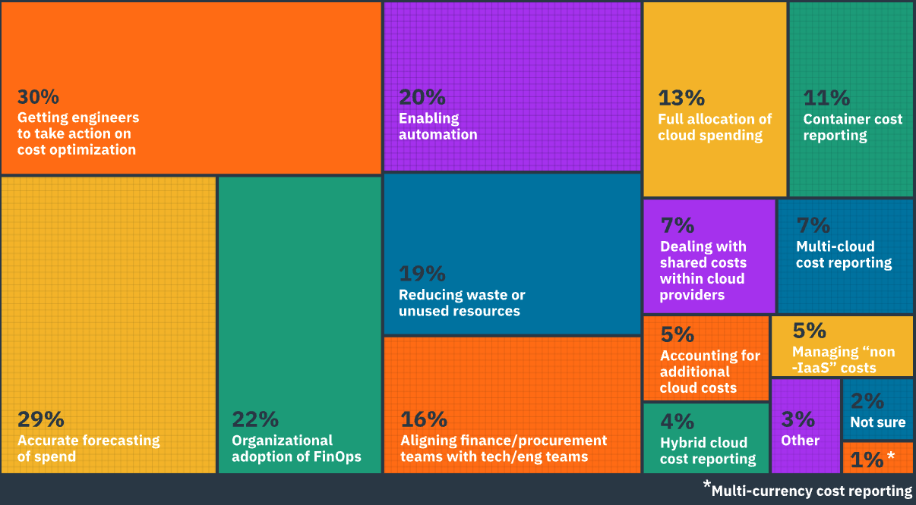
Getting engineering to focus on cost, forecasting and automation are the top challenges identified by FinOps survey responders
Key FinOps Challenges
Why is this so difficult?
Cloud complexity
Skills gap
On-premises habits
The State of FinOps 2022 – FinOps.org Respondents selected their top two choices of Key FinOps Challenges
Notes:
Set the foundation why the better together makes sense – even if they are taking action…
Turbo + Flexera = full picture – performance / cost / license
to accomplish any of these – emphasis on performance, and trust…giving the full picture to build trust

Slide 6
Engineering and Finance need to align priorities
Engineer & Ops Priorities
SLO adherence
Compliance
Cost
Finance Priorities
Cost
Accountability
Business Value

Slide 7
What is required to address the misaligned priorities?
Understand and report costs
Safely minimize consumption
Predictable, Sustainable Business Value

Slide 8
How is this achieved?
Understand costs
Control costs
Predictable, Sustainable Business Value
Reporting Cloud Costs
Automating Cloud Optimization
Chargeback
Budgeting
Forecasting
Performance
Financial Cost
Compliance
Environmental Impact
Automated resource management

Slide 9
FinOps Practitioners and Engineering unite in the FinOps lifecycle
FinOps PRACTICE
Cost visibility across public clouds and on-prem
Allocation of costs to relevant dimensions (including shared)
Chargeback / showback
Budgeting and forecasting
Multi-dimension cost reporting
Currency conversion
ENGINEERING / OPERATIONS
- Reduce the amount you use
Optimize cloud compute, storage, DBaaS, and Kubernetes
Identify and suspend unused or unattached volumes
- Reduce the price you pay
RI-aware compute scaling actions increase existing RI inventory utilization.
Demand-based RI purchasing actions maximize reservation-to-VM coverage.
Rates
& Usage
TOGETHER
- Business SLO/metric-driven optimization
- Automate cloud optimization actions to unlock performance/efficiency opportunities
- Integrate automation with pipelines, processes, and workflows to ensure continuous ROI
- Support operational excellence with cloud cost accountability and unit economics (business / app per cloud spend)

Slide 10
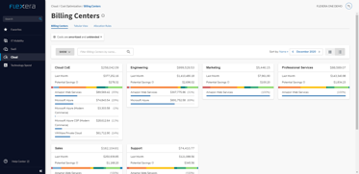
Reporting and automation technology platforms provide transparency to accelerate FinOps adoption and collaboration
Knows exactly what you’re paying for, and who within your organization is incurring those costs.
Automate optimization so apps get exactly the resources they need, when they need them.
FinOps Practitioner
FinOps Framework
Rates
& Usage
Engineering & Ops
Flexera One with IBM Observability Cloud Cost Optimization
IBM Turbonomic Application Resource Management

Slide 11
Turbonomic and Flexera One meet the unique needs of finance and engineering with a focus on business outcomes
Cloud financial management via FinOps
Flexera One with IBM Observability Cloud Cost Optimization helps stakeholders know what they’re paying for and financial impact of recommendations.
Cloud cost and bill management
Cost reporting and dashboarding
Spend allocation and dynamic cost allocation
Application Resource Management
Turbonomic Application Resource Management provides continuous cloud optimization that ensures you only use what you need.
Improve application performance
Increase IT productivity
Reduce public cloud spend due with dynamic scaling and workload resizing¹
33%
¹Forrester Total Economic Impact of IBM Turbonomic Application Resource Management
Notes:
For FinOps side, additional details: Cloud cost and bill management -Complete multi- and hybrid-cloud cost visibility and bill data adjustments ensure you see the full picture in the way you need to report back to the business
Cost reporting and dashboarding - Comprehensive and event-driven reports, budgets, alerts and dashboards provide the most relevant information to the right stakeholders
Spend allocation - Tag management and dynamic cost allocation provide the necessary foundation from which key stakeholders can generate insights and take action

Slide 12
Demo

Slide 13
Take control to limit cloud cost waste with reporting and automation for accountability and sustained business value
Understand costs
Control costs
Predictable, Sustainable Business Value
Flexera One with IBM Observability Cloud Cost Optimization
IBM Turbonomic Application Resource Management
Optimized ROI and ability to accelerate innovation
Chargeback
Budgeting
Forecasting
Performance
Financial Cost
Compliance
Environmental Impact
Automated resource management

Slide 14
Q&A

