Slide 1
Nationwide Test Data Management 2020
IBM VDP POC

Slide 2
NW TDM 2020 Agenda
Introduction
Problem Statement
Nationwide Eco System
Solution
VDP POC Architecture
VDP Testing Results
Closing comments

Slide 3
NW TDM 2020 INTRODUCTION
Testing teams need data to validate Releases:
Run regression suites multiple times
Execute End 2 End Testing
Defect Retesting
Support Continuous Integration/Continuous Delivery(CI/CD) model to achieve speed to market

Slide 4
NW TDM 2020 PROBLEM STATEMENT
The following are the challenges with obtaining relevant data:
Lack of adequate refresh frequency leading to false positives
Downstream interface defects due to inconsistency of data across interfaces
Data Aging
Inadequate Subset Data used in Non-prod Environments
Security risk - PII Data being exposed

Slide 5
Defects Analysis
Source: Q3 2019
26% of defects found are issues relate to data.
Addressing data defects reduces number of batch flows required.

Slide 6
Sample Eco System
INTERFACE | LEVELS
Applications | External | Level 1 | Level 2 | Level 3 | Datamarts | Grand Total
BUYS |  |  | 1 |  |  | 1
Database 5 |  |  | 16 |  |  | 16
DCdirect |  |  | 1 |  |  | 1
EB2B |  |  |  | 1 |  | 1
FINS |  |  | 7 |  |  | 7
Database 2 |  |  | 2 |  |  | 2
Database 3 |  |  | 2 |  |  | 2
Keynote | 20 | 18 |  |  |  | 38
NFDW | 8 |  | 52 |  | 48 | 108
PMTS |  |  | 14 |  |  | 14
Database 4 |  |  | 4 |  |  | 4
Relius |  |  | 1 |  |  | 1
RP Loans |  |  | 2 |  |  | 2
Database 6 |  |  |  | 1 |  | 1
Siebel |  |  |  | 4 |  | 4
STMT |  |  | 1 |  |  | 1
Grand Total | 28 | 18 | 103 | 6 | 48 | 203

Slide 7
Solution : Test Data Management POC
Provision Instant, Lean Prod & Test Gold Copies
Subset & Mask
Prod Data
InfoSphere
InfoSphere
InfoSphere
InfoSphere
Virtual Data
Virtual Data
PIPELINE
PIPELINE
FULL VIRTUAL COPIES
INTEGRATED SUBSETS
DEV1
DEV2
UAT
DEV1
DEV2
UAT
SIT1
SIT2
TRAIN
SIT1
SIT2
TRAIN
Notes:
Why still subset?

Slide 8
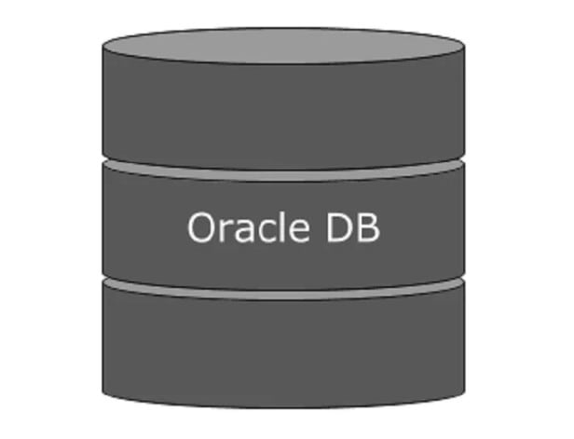
iMedia and Keynote VDP Solutions
Data Source(DR)
IBM InfoSphere Virtual Data Pipeline(VDP)
VDB Test Setup
KEY OBESERVATIONS
IVGM – VDP Appliance
The Database sizes ranged from 500GB to about 3.5TB
Creation times varied from 11 minutes to 1.5 hours
For iMedia, we have cloned all 8 Databases from the Gold copy itself.
For Keynote will have both options to subset or get the entire Gold copy of 1 Database
Setup for Incremental updates in VDP
Due to PII data being the primary key, Oracle TDE encryption was implemented
Virtual DBs/Online Environments
1
Keynote CERT DB
2
3
DB1
Gold Copy
DB1
Live Clone
Subset DB
IK Alpha
Interactive Keynote
Subset Data
Target Replica
Live Clone
iMedia DBs
8 Databases
Gold Copy
4
Alpha Batch
8 Databases
ISC/OLE
Same size as 2X
1
CERT Oracle Databases are used as source
Challenges
ISCI vs NFS mount
Limitations on the shared server
One of the databases took 1.5 hours due to having document links
2
VDP Appliance creates Gold Copy
3
Target Live Clone is created from Gold Copy
4
Virtual Databases are created from IBM VDP

Slide 9
Sample Results
Regression
Performance
Date | Duration (MIN) | Passed | Failed | Pending
6/16/2020 VDP X | 123 123 | 542 568 | 52 25 | 8 8
6/17/2020 VDP X | 129 126 | 523 573 | 79 16
6/18/2020 VDP X | 126 116 | 565 569 | 29 32 | 60 57
6/19/2020 VDP X | 123 84 | 573 580 | 29 21 | 0 1
AVERAGE VDP X | 113 108 | 514 555 | 86 44 | 26 26
Date | Hits/s | Errors | Avg Response (sec) | 90% Response (Sec)
6/16/2020 VDP X | 4.92 4.88 | 0.21 0.21 | 1.54 1.64 | 3.86 4.03
6/17/2020 VDP X | 4.91 4.92 | 0.01 0.00 | 1.54 1.55 | 3.89 3.90
6/18/2020 VDP X | 4.95 4.93 | 0.02 0.01 | 1.45 1.50 | 3.52 3.72
6/19/2020 VDP X | 4.95 4.91 | 0.01 0.03 | 1.46 1.58 | 3.60 3.87
AVERAGE VDP X | 4.92 4.93 | 0.07 0.06 | 1.54 1.50 | 3.77 3.74
Test results were comparable between On-prem and Virtualized databases
ROI is achieved only if you are need a minimum of 3 virtualized databases
Next Steps :
As the results very pretty comparable, we are going ahead with the implementation of VDP in NW, starting with our POC owners, who have made 5 copies each of the 8 databases in play to support their CI/CD pipeline
Actual savings – Using VDP we are seeing a net savings of around $60K/year
Delphix is already in play at Nationwide
VDP is cheaper than Delphix from vantage point of what we were trying to achieve

Slide 10
THANK YOU

