Slide 1
Informix 14.10.xC2 - New Features
Scott Pickett – WW Informix Technical Sales
September 30, 2019

Slide 2
Agenda
KMIP Keystores
Partial Indexes
Statement Cache Improvements
Docker and Informix
Change Data Stream API
Some New UDR’s
JDBC, Wire Listener & Shard Join Improvements
InformixHQ
KandooERP

Slide 3
Informix KMIP Keystores

Slide 4
KMIP Keystores
If a remote key server in a server/cluster supports the KMIP standard, a KMIP keystore can be created:
Can be used by Storage Space Encryption and Integrated Backup Encryption
onkstore ….. –type KMIP
For Integrated Backup Encryption, this type of keystore works similarly with Azure and AWS:
We provide the Key name of a Remote Master Encryption Key that is used to encrypt the Backup Encryption Keys.
For Storage Space Encryption, the Key Name provided is the IDS Master Encryption Key.

Slide 5
Things Needed to Create a KMIP Keystore (1)
The operators must have following information beforehand:
KMIP Server
The IP address or hostname where the KMIP server is listening:
If the port where the server listens is different from the default (5696), the port must be specified (ie “myserver.hcl.com:2356)
KMIP Username
Username to access the KMIP server
Optional since in most cases, the access to the server is done by using SSL certificates
KMIP Password
Password for the given username (optional)
KMIP Client Certificate File
A file containing the certificate for the client
The file must also contain the Private Key matching the certificate
The private key is expected to be a PKCS#8 key
The certificate is expected to have Authentication extensions
KMIP CA Certificate File
File containing the root CA signing both the KMIP Client Certificate File and the KMIP Server Certificate File

Slide 6
Things Needed to Create a KMIP Keystore (2)
The operators must have following information at hand (cont’d) :
KMIP Key Name (optional)
The name of the KMIP Key used as Master Encryption Key by the Storage Spaces Encryption Feature or as Remote Master Encryption Key by the Integrated Backup Encryption Feature.
If not present, onkstore will generate a new key and report its Id to the operator.

Slide 7
onkstore Syntax, Quick Review
The onkstore utility has the following syntax usage:
-file <fn> name of keystore to create/list/convert
-type
Type of keystore to create: local, AWS-EAR, AWS-BAR, KMIP, AZURE-EAR, AZURE-BAR
-list list the contents of the file.
-cipher
Cipher the server will use: aes128, aes192, aes256
-credential <fn> file that contains credentials in json format
-pw [<fn>]
Current password for the keystore, supplied either interactively or in a file
-verify verify the keystore
-convert convert keystore from one type to another
-changepw [<fn>] change the password for the keystore
-help print this message

Slide 8
Informix Partial Index

Slide 9
Informix Partial index
Partial Index, also known as filtered index, is an index having some condition applied to it so that it includes a subset of rows in the table
Starting in Informix 14.10xC2 supports Fragment By Expression Partial Index only as Phase 1
Fragment eliminate and use INDEX-OFF clause to avoid index build/use
Reduces index build times and less index disk usage
Absent an index, its not hard to guess how a query will run over unindexed table fragments in fragment by expression clauses
Can you say sequential scan ……….

Slide 10
Create Partial Index - Syntax
Expression Fragment Clause in Create Index
Optional ‘INDEX OFF’ specifying index is turned off for rows meeting the expression condition
|----+------------------------+--+-expr-------+--IN--dbspace-+-----------------+-->
'-PARTITION--part-’ '-(--expr-----)-’ ‘-INDEX OFF’
>--+------------------------------------------------+---------------|
'-,--+------------------------+-REMAINDER--IN--dbspace-’+-----------------+---
'-PARTITION--part-’ ’-INDEX OFF-’
Example:
Create index zip_ix on customer(zipcode)
fragment by expression
(state = 'CA') in dbs2,
remainder INDEX OFF; -- no index for remainder

Slide 11
Example with dbaccessdemo table
create table customer (
customer_num serial(101),
fname char(15),
lname char(15),
company char(20),
address1 char(20),
city char(15),
state char(2),
zipcode char(5),
phone char(18),
primary key (customer_num));
create index zip_ix on customer(zipcode) fragment by expression
(state = 'AZ') in dbs1 INDEX OFF;
# above line can be removed, for testing
(state = 'CA') in dbs2,
# only index structure that will be created for this table
remainder INDEX OFF;
For the example below, only build the index for rows with (state = ‘CA’)

Slide 12
Queries with Partial Index
Query that can use the index zip_ix would be:
select fname, lname from customer
where zipcode = '94117’ and state='CA’;
Query that cannot use the index is:
select fname, lname from customer
where zipcode = '85016' and state='AZ';

Slide 13
Index Scan Explain
select fname, lname from customer
where zipcode = '94117'
and state='CA'
Estimated Cost: 1
Estimated # of Rows Returned: 1
1) informix.customer: INDEX PATH
Filters: informix.customer.state = 'CA'
(1) Index Name: informix.zip_ix
Index Keys: zipcode (Serial, fragments: 1)
Fragments Scanned: (1) dbs2
Lower Index Filter: informix.customer.zipcode = '94117'
Query statistics:
-----------------
Table map :
----------------------------
Internal name Table name
----------------------------
t1 customer
type table rows_prod est_rows rows_scan time est_cost
-------------------------------------------------------------------
scan t1 1 1 1 00:00.00 1

Slide 14
xtrace

Slide 15
Sequential Scan Set Explain Output
select fname, lname from customer
where zipcode = '85016'
and state='AZ'
Estimated Cost: 4
Estimated # of Rows Returned: 1
1) informix.customer: SEQUENTIAL SCAN
Filters: (informix.customer.zipcode = '85016' AND informix.customer.state = 'AZ' )
Query statistics:
-----------------
Table map :
----------------------------
Internal name Table name
----------------------------
t1 customer
type table rows_prod est_rows rows_scan time est_cost
-------------------------------------------------------------------
scan t1 1 1 28 00:00.00 5

Slide 16
xtrace

Slide 17
Example with FOT Index
create table tab1 (n int, n2 int, n4 int, cc char(16));
create index idx1 on tab1(n) fragment by expression
(n2 is null) in dbs1 INDEX OFF, remainder in dbs2
hash on (n) with 100 buckets;
-- insert 10,000 rows
with cte(n) as (select 1 as n union all select n+1 from cte where n < 10000)
insert into tab1 select n, case when mod(n,10) == 0 then n else null end, mod(n,4), n from cte;
-- 10% index keys
oncheck -pk test:tab1 | grep '^Key' | wc –l 1000

Slide 18
Limits and Possibilities
CREATE INDEX … FRAGMENT BY EXPRESSION only
Must return data values from a single row of a table
Must drop partial indexes if you revert to a previous server version
Futures work
Create table ... Fragment by … Index Off
Create index idx on tab (col) where …

Slide 19
Thank You – A Query
with fonts(c, c1, c2,c3,c4,c5,c6,c7,c8) as (
select * from table(multiset{ -- public domain vga 8x8 fonts
ROW(' ', '0x00', '0x00', '0x00', '0x00', '0x00', '0x00', '0x00', '0x00'), ROW('!', '0x18', '0x3C', '0x3C', '0x18', '0x18', '0x00', '0x18', '0x00'),
ROW('A', '0x0C', '0x1E', '0x33', '0x33', '0x3F', '0x33', '0x33', '0x00'), ROW('B', '0x3F', '0x66', '0x66', '0x3E', '0x66', '0x66', '0x3F', '0x00'),
ROW('C', '0x3C', '0x66', '0x03', '0x03', '0x03', '0x66', '0x3C', '0x00'), ROW('D', '0x1F', '0x36', '0x66', '0x66', '0x66', '0x36', '0x1F', '0x00'),
ROW('E', '0x7F', '0x46', '0x16', '0x1E', '0x16', '0x46', '0x7F', '0x00'), ROW('F', '0x7F', '0x46', '0x16', '0x1E', '0x16', '0x06', '0x0F', '0x00'),
ROW('G', '0x3C', '0x66', '0x03', '0x03', '0x73', '0x66', '0x7C', '0x00'), ROW('H', '0x33', '0x33', '0x33', '0x3F', '0x33', '0x33', '0x33', '0x00'),
ROW('I', '0x1E', '0x0C', '0x0C', '0x0C', '0x0C', '0x0C', '0x1E', '0x00'), ROW('J', '0x78', '0x30', '0x30', '0x30', '0x33', '0x33', '0x1E', '0x00'),
ROW('K', '0x67', '0x66', '0x36', '0x1E', '0x36', '0x66', '0x67', '0x00'), ROW('L', '0x0F', '0x06', '0x06', '0x06', '0x46', '0x66', '0x7F', '0x00'),
ROW('M', '0x63', '0x77', '0x7F', '0x7F', '0x6B', '0x63', '0x63', '0x00'), ROW('N', '0x63', '0x67', '0x6F', '0x7B', '0x73', '0x63', '0x63', '0x00'),
ROW('O', '0x1C', '0x36', '0x63', '0x63', '0x63', '0x36', '0x1C', '0x00'), ROW('P', '0x3F', '0x66', '0x66', '0x3E', '0x06', '0x06', '0x0F', '0x00'),
ROW('Q', '0x1E', '0x33', '0x33', '0x33', '0x3B', '0x1E', '0x38', '0x00'), ROW('R', '0x3F', '0x66', '0x66', '0x3E', '0x36', '0x66', '0x67', '0x00'),
ROW('S', '0x1E', '0x33', '0x07', '0x0E', '0x38', '0x33', '0x1E', '0x00'), ROW('T', '0x3F', '0x2D', '0x0C', '0x0C', '0x0C', '0x0C', '0x1E', '0x00'),
ROW('U', '0x33', '0x33', '0x33', '0x33', '0x33', '0x33', '0x3F', '0x00'), ROW('V', '0x33', '0x33', '0x33', '0x33', '0x33', '0x1E', '0x0C', '0x00'),
ROW('W', '0x63', '0x63', '0x63', '0x6B', '0x7F', '0x77', '0x63', '0x00'), ROW('X', '0x63', '0x63', '0x36', '0x1C', '0x1C', '0x36', '0x63', '0x00'),
ROW('Y', '0x33', '0x33', '0x33', '0x1E', '0x0C', '0x0C', '0x1E', '0x00'), ROW('Z', '0x7F', '0x63', '0x31', '0x18', '0x4C', '0x66', '0x7F', '0x00'),
ROW('~', '0x6E', '0x3B', '0x00', '0x00', '0x00', '0x00', '0x00', '0x00')})),
text(str) as (select 'THANK YOU!'),
xword(str, o, c, c1, c2,c3,c4,c5,c6,c7,c8) as (
select str, 1, c, c1, c2,c3,c4,c5,c6,c7,c8 from text, fonts where c = substr(str, 1, 1)
union all
select str, o+1, c, c1, c2,c3,c4,c5,c6,c7,c8 from fonts, xword where fonts.c = substr(str, o+1, 1) and o < length(str)),
x(n, p) as ( select 1, 128 union all select n+1, p/2 from x where n < 8),
show as (select sum ((case when bitand(to_number(c1)::int, p) > 0 then '#' else ' ' end)::lvarchar)::char(8) as c1,
sum ((case when bitand(to_number(c2)::int, p) > 0 then '#' else ' ' end)::lvarchar)::char(8) as c2,
sum ((case when bitand(to_number(c3)::int, p) > 0 then '#' else ' ' end)::lvarchar)::char(8) as c3,
sum ((case when bitand(to_number(c4)::int, p) > 0 then '#' else ' ' end)::lvarchar)::char(8) as c4,
sum ((case when bitand(to_number(c5)::int, p) > 0 then '#' else ' ' end)::lvarchar)::char(8) as c5,
sum ((case when bitand(to_number(c6)::int, p) > 0 then '#' else ' ' end)::lvarchar)::char(8) as c6,
sum ((case when bitand(to_number(c7)::int, p) > 0 then '#' else ' ' end)::lvarchar)::char(8) as c7,
sum ((case when bitand(to_number(c8)::int, p) > 0 then '#' else ' ' end)::lvarchar)::char(8) as c8
from x cross join xword group by xword.o order by xword.o desc)
select sum(c1::lvarchar) as _1, sum(c2::lvarchar) as _2, sum(c3::lvarchar) as _3, sum(c4::lvarchar) as _4,
sum(c5::lvarchar) as _5, sum(c6::lvarchar) as _6, sum(c7::lvarchar) as _7, sum(c8::lvarchar) as _8 from show;

Slide 20
Thank You
Database selected.
_1 ###### ## ## ## ## ## ### ## ## ## ### ## ##
_2 # ## # ## ## #### ### ## ## ## ## ## ## ## ## ##
_3 ## ## ## ## ## #### ## ## ## ## ## ## ## ## ##
_4 ## ###### ## ## ## #### #### #### ## ## ## ##
_5 ## ## ## ###### ## ### ## ## ## ## ## ## ##
_6 ## ## ## ## ## ## ## ## ## ## ## ## ## ##
_7 #### ## ## ## ## ## ## ### ## #### ### ######
_8
1 row(s) retrieved.
Database closed.

Slide 21
Questions

Slide 22
Informix 14 Statement Cache Improvements

Slide 23
Agenda
What problems are we trying to solve?
New sysmaster:syssscelem pseudo table similar to onstat -g ssc
Dump query plan from statement(s) in Statement Cache
Invalidate specific statement(s) in the Statement Cache
Lock query plan(s) in the Statement Cache

Slide 24
What problem are we trying to solve?
System is stable and the statement cache is in a steady state
Suddenly there is a performance problem:
Customer analysis discovers ‘update statistics’ was run on some table(s)
Statement Cache entries with those tables are invalidated, by design
Statements are reoptimized
New optimization produces query plans that are less desirable
Prior to 14.10.xC2,, the ONLY option is to flush the entire Statement Cache with ‘onmode –e flush’
Having the ability to view query plans, lock and invalidate specific statements, gives the user more leverage to control and react to these situations

Slide 25
New sysmaster:syssscelem table
Column name Type Nulls
uniqid integer yes
lru integer yes
hash integer yes
ref_cnt integer yes
hits integer yes
flag integer yes
valid integer yes // differs from onstat –g ssc
locked integer yes // differs from onstat –g ssc
heap_ptr bigint yes
database char(128) yes
user char(32) yes
stmtstring char(16000) yes
queryplan char(16000) yes // differs from onstat –g ssc
Notes:
Presently, the largest a query can be is 32000 characters in Informix sysmaster. This is a limit to be overcome in a future release. Yes, if the stmtstring or the queryplan are larger that the column size in characters, they are chopped off. If the statement is larger than what is here, you should be able to find it in sysmaster:sysconblock.cbl_stmt or sysmaster:syssqexplain.sqx_sqlstatement or sysmaster:syssqlcurses.scs_sqlstatement, if the statement is live.
The above three columns are all 32000 characters in length.

Slide 26
onstat –g ssc
Statement Cache Entries:
uniqid lru hash ref_cnt hits flag heap_ptr database user
--------------------------------------------------------------------------------
5 0 2404 0 0 -F- 461b1038 stores_demo jmcmahon
select count(*) from items
Notes:
onstat –g ssc differs a little bit from the sysmaster:syssscelem pseudo table it now mirrors. The valid column is not immediately present, locked is not present by name but rather is found in the Flags column, And the queryplan column of the table is not present here because of its variable size on output; it can be quite big.
onstat –g ssc above is partial output, showing only the statement cache entries. The statement cache summary is missing from the output and has been edited out for readability.
The Statement Cache Entries section shows the entries that are fully inserted into the cache:
uniqid The unique id of the statement in the cache
lru The index of lru queue to which the cache entry belongs
hash Hash values of cached entry
ref_cnt Number of threads referencing the statement
hits Number of times a statement matches a statement in the cache. The match can be for a key-only or fully cached entry.
flag Cache entry flag -D indicates that the statement is dropped, -F indicates that the statement is fully cached, and -I indicates that the statement is in the process of being moved to a fully cached state heap_ptr Address of memory heap for cache entry
database Current database being accessed by the statement in the query cache
user User name executing the statement presently that is in the statement cache

Slide 27
Sysmaster:syssscelem – sample output
uniqid 5
lru 0
hash 2404
ref_cnt 0
hits 0
flag 2
valid 1
locked 0
heap_ptr 1176178744
database stores_demo
user jmcmahon
stmtstring select count(*) from items
queryplan DISABLED

Slide 28
Dump query plan from queries in Statement Cache
New onconfig parameter STMT_CACHE_QUERY_PLAN
# STMT_CACHE_QUERY_PLAN - Stores query plan for each SQL statement
# Acceptable values are:
# 0 Disabled
# 1 Enabled
Disabled by default
Dynamically tunable with onmode –wf/-wm
Note that if enabled, this WILL consume more of your STMT_CACHE_SIZE memory!!!!
Query plan is viewable in sysmaster:syssscelem.queryplan column

Slide 29
syssscelem.queryplan – sqexplain.out is the same
←-----→
database stores_demo
user jmcmahon
stmtstring select count(*) from items
queryplan
QUERY:
------
select count(*) from items
Estimated Cost: 1
Estimated # of Rows Returned: 1
1) informix.items: INDEX PATH
(1) Index Keys: (count)

Slide 30
Invalidate specific statement in the Statement Cache
Set sysmaster:syssscelem.valid column to 0 (as user Informix)
update syssscelem set valid = 0 where uniqid = 6
1 row(s) updated.
Once statement is invalidated, it cannot be re-validated
onstat –g ssc (notice ‘D’ flag indicating entry is now invalid)
Statement Cache Entries:
uniqid lru hash ref_cnt hits flag heap_ptr database user
--------------------------------------------------------------------------------
6 0 2404 0 0 DF- 46431038 stores_demo jmcmahon
select count(*) from items
Notes:
Sysmaster is a database in memory only and the updates, new to sysmaster, will not survive a database boot so script this in your startup scripts after the sysmaster database is built fully.

Slide 31
Invalidate specific query in the Statement Cache
Also notice flag is 0x3 (invalid 0x1 | fully inserted 0x2) and valid is now 0 (invalid)
uniqid 6
lru 0
hash 2404
ref_cnt 0
hits 0
flag 3
valid 0
locked 0
heap_ptr 1178800184
database stores_demo
user jmcmahon
stmtstring select count(*) from items
queryplan DISABLED

Slide 32
Lock a query plan in the Statement Cache
Locking statement will avoid re-optimization when minor version of any table in statement changes (i.e. update statistics)
Set sysmaster:syssscelem.locked column to 1 (as user Informix)
update syssscelem set locked = 1 where uniqid = 7
1 row(s) updated.
Statement can be locked and unlocked at any time.
onstat –g ssc (notice ‘L’ flag indicating entry is now locked)
Statement Cache Entries:
uniqid lru hash ref_cnt hits flag heap_ptr database user
--------------------------------------------------------------------------------
7 1 2404 0 0 -FL 4621e038 stores_demo jmcmahon
select count(*) from items
Notes:
Sysmaster is a database in memory only and the updates, new to sysmaster, will not survive a database boot so script this in your startup scripts after the sysmaster database is built fully.

Slide 33
Lock a query plan in the Statement Cache
Also notice flag is 0x10 (locked 0x8| fully inserted 0x2) and locked is now 1 (locked)
uniqid 7
lru 1
hash 2404
ref_cnt 0
hits 0
flag 10
valid 1
locked 1
heap_ptr 1176625208
database stores_demo
user jmcmahon
stmtstring select count(*) from items
queryplan DISABLED

Slide 34
Questions

Slide 35
Informix and Docker

Slide 36
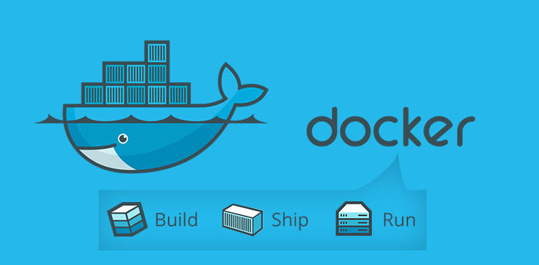
What is Docker
A tool designed to make it easier to create, deploy, and run applications by using containers
Containers allow a developer to package up an application with all parts needed, such as libraries and other dependencies, and ship it all out as one package
The application will run on any other Linux machine regardless of any customized settings that machine might have that could differ from the machine used for writing and testing the code
Simple method to create microservices

Slide 37
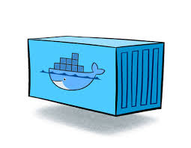
Images & Containers
An image is an inert, immutable, object/file created with the docker build command, and your application and all of its dependencies installed
Images are typically stored in a Docker registry such as Docker Hub or a private registry
A container is a running instance of an image

Slide 38
Informix Images on Dockerhub
Informix Innovator-C Edition
Free IBM Informix Database for limited production use.
Informix Developer Edition
Fully featured IBM Informix Database free for non-production use.
Docker Hub
$docker pull ibmcom/informix-innovator-c
100k+ downloads
$docker pull ibmcom/informix-developer-database

Slide 39
Build Your Own
Docker
This repo contains docker build files used by the Informix Docker images on Dockerhub.
This is an open source project. These build files are not supported through IBM/HCL.
https://github.com/informix/informix-server-dockerfiles
$git clone https://github.com/informix/informix-server-dockerfiles

Slide 40
What is Supported?
Informix usage in containerized or virtual environments is fully supported
If a customer runs supported Informix versions, they can open support tickets for Informix product
Informix Developer and Innovator-C Editions are made available on dockerhub as a convenience
Docker files used to build the image and scripts used for custom setup are open sourced and available under the Apache 2.0 license
Docker files and associated scripts are maintained by the Informix community and not entitled for support through IBM
As open source, files & scripts may change frequently

Slide 41
Run the Docker Image
To run the docker image use the docker run command
Provide any docker run options as necessary
Provide appropriate environment options to configure the docker container accordingly at run time. (ex. -e LICENSE=accept)
When the container is run for the first time the database server is initialized with oninit –iy
docker run –it –name ifx –h ifx \
-p 9088:9088 \
-p 27018:27018 \
-e LICENSE=accept \
ibmcom/informix-developer-database

Slide 42
Docker Image Options
All docker image options are provided through an environment variable passed in on the docker run command
Specify a SIZE option that will auto configure the Informix database
Small/medium/large
Storage of data can be of the following:
Volume – managed by docker
Mount Point – user managed directory mount point
Local storage – data stored inside the container
Disable various connection ports at runtime
All connectivity ports are enabled by default

Slide 43
Docker Image Options (cont’d)
Provide an sql_init_informix.sql file:
Used to configure/create your Informix instance and databases
Provide a user supplied ONCONFIG and SQLHOSTS file
Provide scripts to run pre/post oninit within the container
Provide a user supplied shell script to configure the system 100% manually
Provide a way to bypass initialization and configuration at runtime
Allow the Informix HQ server to be started
Allow the Informix HQ agent to be started and auto configure with the HQ server

Slide 44
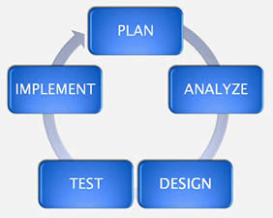
Use Case – Create a test system
Create a self contained test system using the Informix image on dockerhub with all storage saved within container and saved as a re-usable docker image
Run the initial image with an option –e STORAGE=local
Connect to the docker container and create any dbspaces/chunks
Create databases and tables and load any data needed for a test system
Take informix offline
Commit & save the new docker image
New docker image can be used as a test system and is configured with the dbspaces and data that you created
Can be passed around to your development teams for development and testing purposes

Slide 45
Use Case – Upgrade to Enterprise Edition
Use the docker image as an installed product and not run any setup/configuration scripts during startup:
Run the initial image with an option –e CONFIGURE_INIT=no
Connect to the docker container
You are now into an environment where Informix is installed but not configured
Run the Edition installer to upgrade the database server and create an Informix database instance per your requirements
Take informix offline
Commit and save the new docker image
This new docker image can be used in your production environment assuming the correct licensing

Slide 46
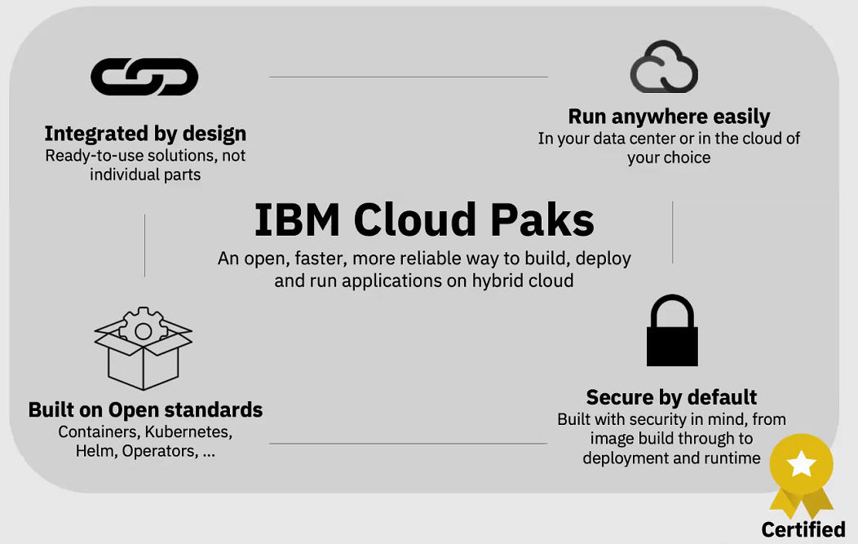
ICP – (Cloud Pak for Data/Openshift)
We are working with the ICP team to onboard Informix as an Add on in the Cloud Pak for Data for a later Q4 2019 release:

Slide 47
Questions

Slide 48
Informix Change Data Stream API

Slide 49
Informix Change Data Capture (CDC)
Processes Informix logical logs (log replay)
Data processed sent to the client application over a large object API found in many drivers
ESQL/C example in $INFORMIXDIR/demo/cdc
Java API releasing with 14.10.xC2
Supports basic data types as well as LOBs
Does not support UDT’s
Supports a large set of record types
Begin work, commit/rollback, truncate, insert/update/delete records
Can be used to stream entire database systems for heterogeneous replication

Slide 50
Informix Data Streaming
A practice whereby data is manipulated within a database and events (triggers) are generated by it that can be processed by either a database or an external application:
No changes to your configurations or topologies
Applications are unaffected
Data is pushed out to users by the server
Subscription model, get only the data you want to see (rows, changes, etc)
No polling of the database
All data can be filtered and preprocessed

Slide 51
Informix Java Change Data Stream Library API
Java client library for working with Informix change data capture
Must have JDBC 4.50.JC2 installed
Includes javadocs, JDBC installer
syscdcv1 database needs to be created and connected to
Execute the $INFORMIXDIR/etc/syscdcv1.sql script beforehand
Takes a Data Source objects as a constructor

Slide 52
Java Sample Code
Connection String
Data Source & Builder
Initialize CDC engine, Connection creation,
Listens for data changes
Loop pulls up changes in the data you are watching to the app
Notes:
https://en.wikipedia.org/wiki/Builder_pattern#Java
An important note here is that this was originally done in Changed Data Capture (CDC) with Informix ESQL/C and this ws approximately 2000 lines of code to accomplish exactly as seen in the slide above in about 20 lines of code.
At its foundation, these Java procedures invoke blocking socket calls; for example, the loop in the code above will block.
All of these Java classes extend the Java runnable to extend into a thread. They all have call back API’s as part of the library. You can register and get notified when a event happens and so you can put all of this into a background thread in Java as part of the library (not shown).

Slide 53
A Lot More Accomplished in A Lot Less Time and Code
Important:
What was seen on the previous slide was done in ~20 or so lines of code
Same exact functionality was originally done in Changed Data Capture (CDC) in Informix version 12 and earlier with Informix ESQL/C and this was approximately 2000 lines of code
A very powerful method to stream data server changes out of the engine
Comes with Informix 14.10.xC2 at no extra cost

Slide 54
Informix Data Streaming Technology Summary

Slide 55
Questions

Slide 56
Informix Some New UDR’s

Slide 57
Additional Built in UDR’s
Defined per database
Easy for Java to add
Automatically built-in to the server
Manual registration process
May auto register in the future

Slide 58
UUID – Built-in UDR to J/Foundation – Customer Requested
Based on a Java function to provide a UUID.
Notes:
https://docs.oracle.com/javase/7/docs/api/java/util/UUID.html
Oracle doc says that it returns 128 bit so this does something different behind the scenes to return 36 characters.

Slide 59
Replace_All UDR
Replace_All
Replace all matches of a character string with another string
https://docs.oracle.com/javase/8/docs/api/java/lang/String.html#replaceAll-java.lang.String-java.lang.String-
create function REPLACE_ALL(VARCHAR(255), VARCHAR(255), VARCHAR(255)) RETURNING VARCHAR(255)
EXTERNAL NAME 'com.informix.judrs.IfxStrings.replaceAll(String, String, String)' language java;
$ CREATE TABLE test(a varchar(255));
$ INSERT INTO test VALUES('I like dogs’);
$ SELECT REPLACE_ALL(a, 'dogs', 'cats') FROM test; a
I like cats
1 row(s) retrieved.

Slide 60
Base64 UDR
Generates an ASCII Base64 encoding of a binary object
Careful of the size if the blob is large!
$ create FUNCTION BASE64(BLOB) RETURNING LVARCHAR EXTERNAL NAME 'com.informix.judrs.IfxStrings.encodeBase64(Blob)’
language java;
$ SELECT id, BASE64(blobColumn) AS data FROM blobTable; id data
1
TG9yZW0gaXBzdW0gZG9sb3Igc2l0IGFtZXQsIH ZpZGUgaGFiZW8gdmVsIGV4LCBpbGx1bSBsYWJv cmVzIHF1byB1dC4gRXQgZXJvcyBkZWxlY3R1cy BhbnRpb3BhbSBlc3QuIEVzc2VudCBtZWxpb3Jl IGFyZ3VtZW50dW0gdmltIGVhLCBzaXQgYXVndW UgcGxhdG9uZW0g

Slide 61
Base64 UDR
There is not a IBM Informix provided way to revert a base64 encoded object to the original coding, say a blob for example
Typically the client application would use a library to transform it into binary form
Most programming languages have built in libraries or easy to download code to convert base64 back to binary in a structure that the language uses for binary data
One such method, can be found here
Notes:
https://stackoverflow.com/questions/469695/decode-base64-data-in-java

Slide 62
Questions

Slide 63
JDBC & Wire Listener & Shard Join Enhancements

Slide 64
JDBC
Upgrades to IfxBSONObject.java
Better performance using RAW bson documents
Raw documents are the purest form of BSON as compared to the parsed out form into JAVA objects
Caching of JSON keys when using raw documents
More APIs keep BSON documents in ‘raw’ binary form
Ability to query a char/varchar/lvarchar column and treat it like a CLOB
Application compatibility feature
Gets an immutable Clob object
Can then use clob.getAsciiStream(), position(…), getCharacterStream() and other read only Clob operations
Notes:
Immutable - In object-oriented and functional programming, an immutable object (unchangeable object) is an object whose state cannot be modified after it is created.

Slide 65
Wire Listener
Faster Performance
Code path analysis of BSON documents
10-15% improvement in speed over common code paths
Native timeseries queries
Can directly queries timeseries columns and use timeseries functions like Clip
Renders the timeseries as a subdocument
Be aware of the size of the timeseries queried!
http://localhost:28000/stores_demo/system.sql?query={"$sql" :
"SELECT Clip(raw_reads, '2010-11-10 00:15:00'::datetime year to second, '2010-11-
10 00:30:00'::datetime year to second) AS results FROM ts_data WHERE loc_esi_id = 4727354321000111“}
Decimal128 support
Mongo compatibility
Maps to Informix Decimal
Notes:
https://api.mongodb.com/python/3.4.0/api/bson/decimal128.html

Slide 66
Shard Join Improvements
There have been Improvements in Shard Joins for instances that use sharding:
Joins between 2 sharded tables are allowed only when:
Both the shard table must have the joining column as KEY
Both must have exactly the same strategy defined on the KEY
Both must have exact partitioning conditions defined using the KEY
Both must have same set of the participating nodes
Only equi-joins are allowed in case of other non-expression strategies
No cross product among shard tables
Qualified conditions on the query
Previously, in some cases errors were produced and in others nothing was produced except data, even though there were errors

Slide 67
SELECT * FROM t1, t2 WHERE t1.c1 = t2.c1;
Shard Collection:t1_shard Version:0
type:expression
key:c1 Version Column:version
Table:sharddb:informix.t1
utm_group_1 c1 between 1 and 3
utm_group_2 c1 is null or not (c1 between 1 and 3 )
Shard Collection:t2_shard Version:0
type:expression
key:c1 Version Column:version
Table:sharddb:informix.t2
utm_group_1 c1 between 1 and 3
utm_group_2 c1 is null or not (c1 between 1 and 3 )

Slide 68
New Shard Error Message Format for Number -26995 (1)
"due to shard keys different from join keys"
When the join-key does not match with the shard key of that table
"due to shard strategy mismatch among join keys"
When the strategy (like CHASH, HASH, EXPRESSION) does not match
"due to shard condition mismatch"
The expression used to create 2 shards are different
"due to internal shard error"
Unknown shard internal error – The filters turned out to be NULL

Slide 69
New Shard Error Message Format for Number -26995 (1)
"due to number of shard nodes mismatch"
Number of nodes for shards are different
"due to inequality join among shard tables"
Join must be equi-join
“due to cross product among shard tables”
Cross product among 2 sharded tables are not allowed
“due to unqualified conditions”
No qualified predicates on the query
All other shard-join error will simply return
26995: The shard-join is not possible .

Slide 70
New Error: 26995: The shard-join is not possible %s
"due to number of shard nodes mismatch"
Number of nodes for shards are different
"due to inequality join among shard tables"
Join must be equi-join
“due to cross product among shard tables”
Cross product among 2 sharded tables are not allowed
“due to unqualified conditions”
No qualified predicates on the query
All other shard-join error will simply return
26995: The shard-join is not possible .

Slide 71
Questions

Slide 72
InformixHQ – What’s New

Slide 73
Agenda
What’s New in 14.10.xC2?
Customization
Administration
Usability Enhancements

Slide 74
Customization
Custom Dashboards
Single or multi-server dashboards
Define what monitoring data you want to see
Drag, drop, resize, select colors to customize the look and feel
Dynamically change the server or set of servers shown on your dashboard
Custom SQL sensors
Define your own SQL based sensors to customize what data is collected by the HQ agent.
Any sysmaster SQL query can now be turned into a sensor
Easy to use UI for defining sensors, including a preview of sensor data
Extensible Alerting
Define a custom script to be executed whenever an alerting incident occurs

Slide 75
Custom Dashboards
Custom dashboards allow you to define UI pages that show you the Informix monitoring data that is most important to you
Single or multi-server dashboards
Define what monitoring data you want to see
Drag, drop, resize, select colors to customize the look and feel
Dynamically change the server or set of servers shown on your dashboard

Slide 76
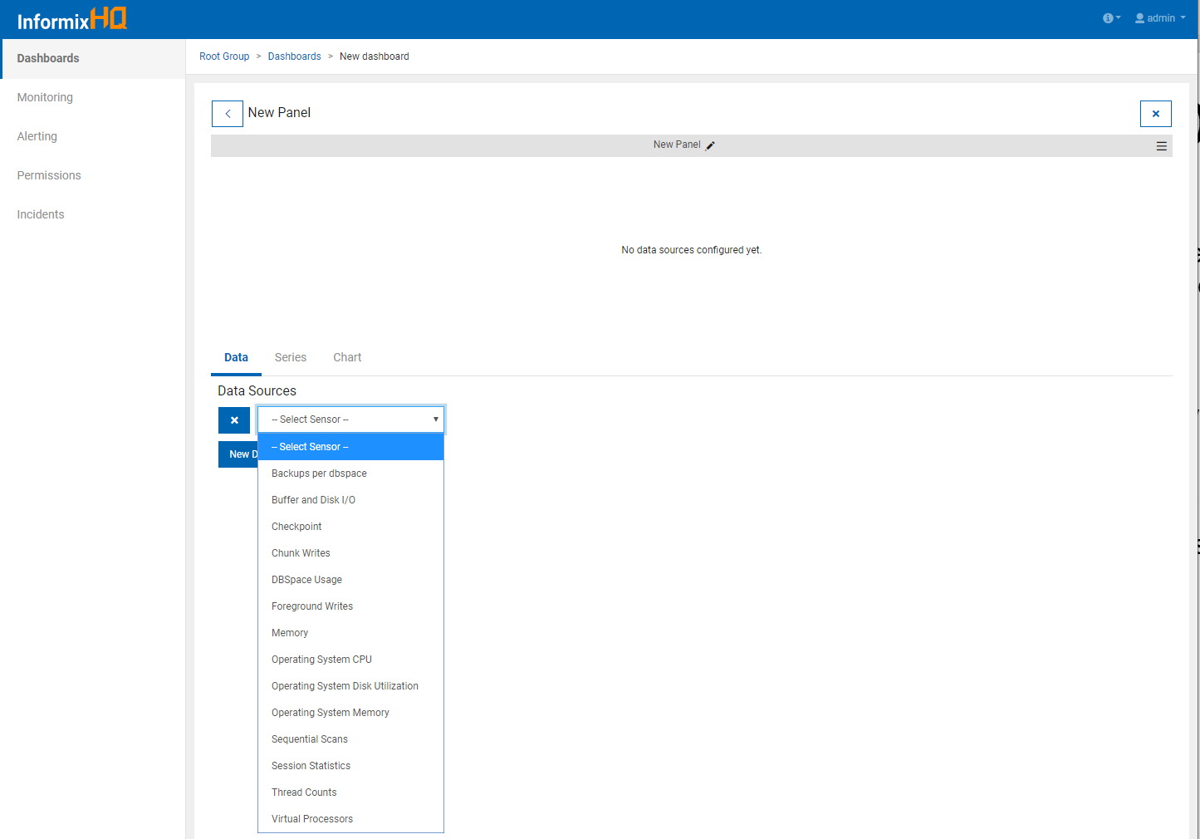

Slide 77
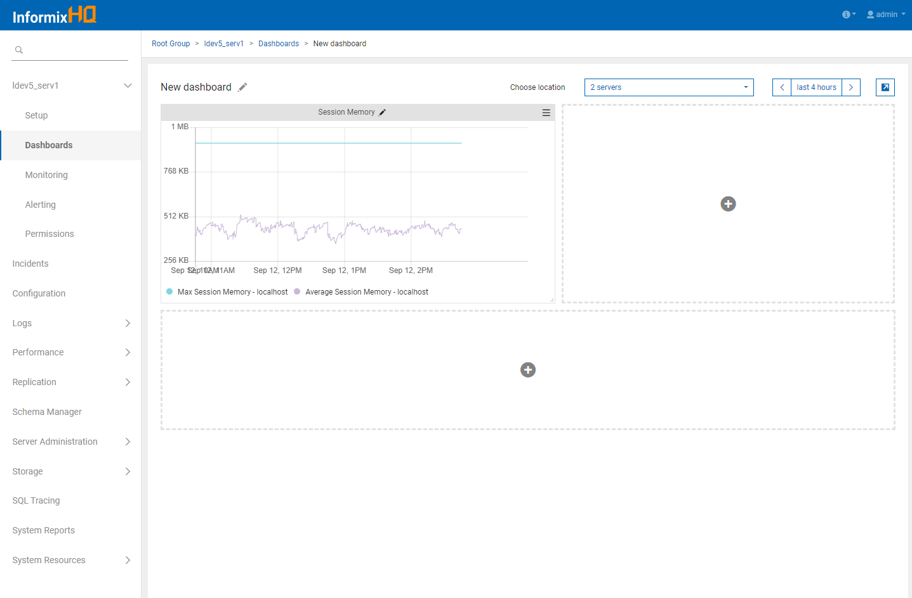

Slide 78
Custom SQL Sensors
Define your own SQL based sensors to customize what data is collected by the HQ agent
Any sysmaster SQL query can now be turned into a sensor
Easy to use UI for defining sensors, including a preview of sensor data

Slide 79
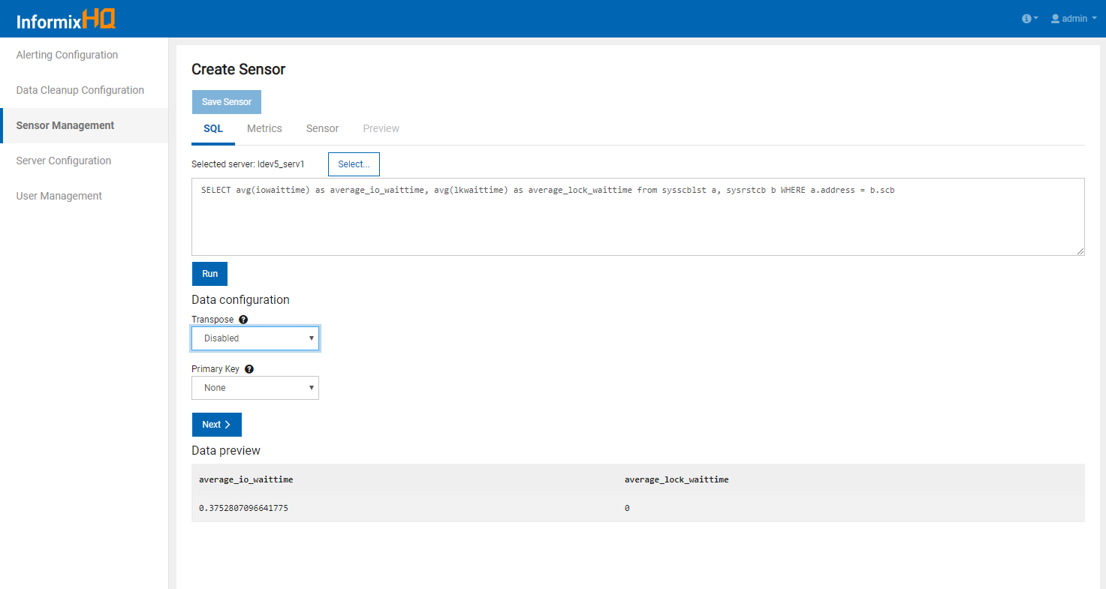

Slide 80
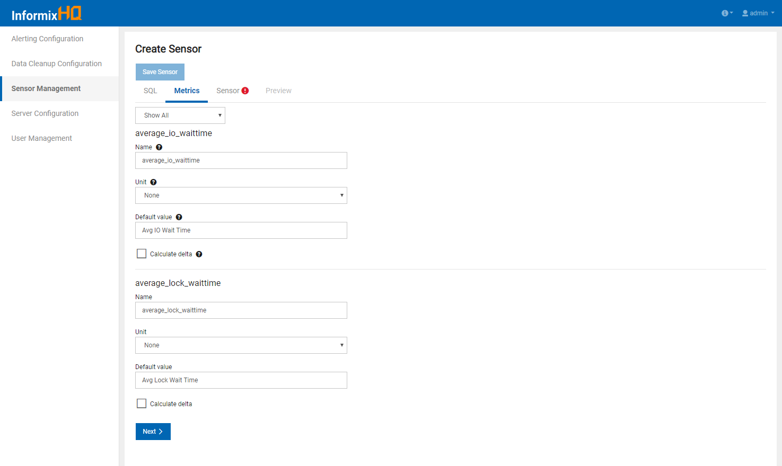

Slide 81
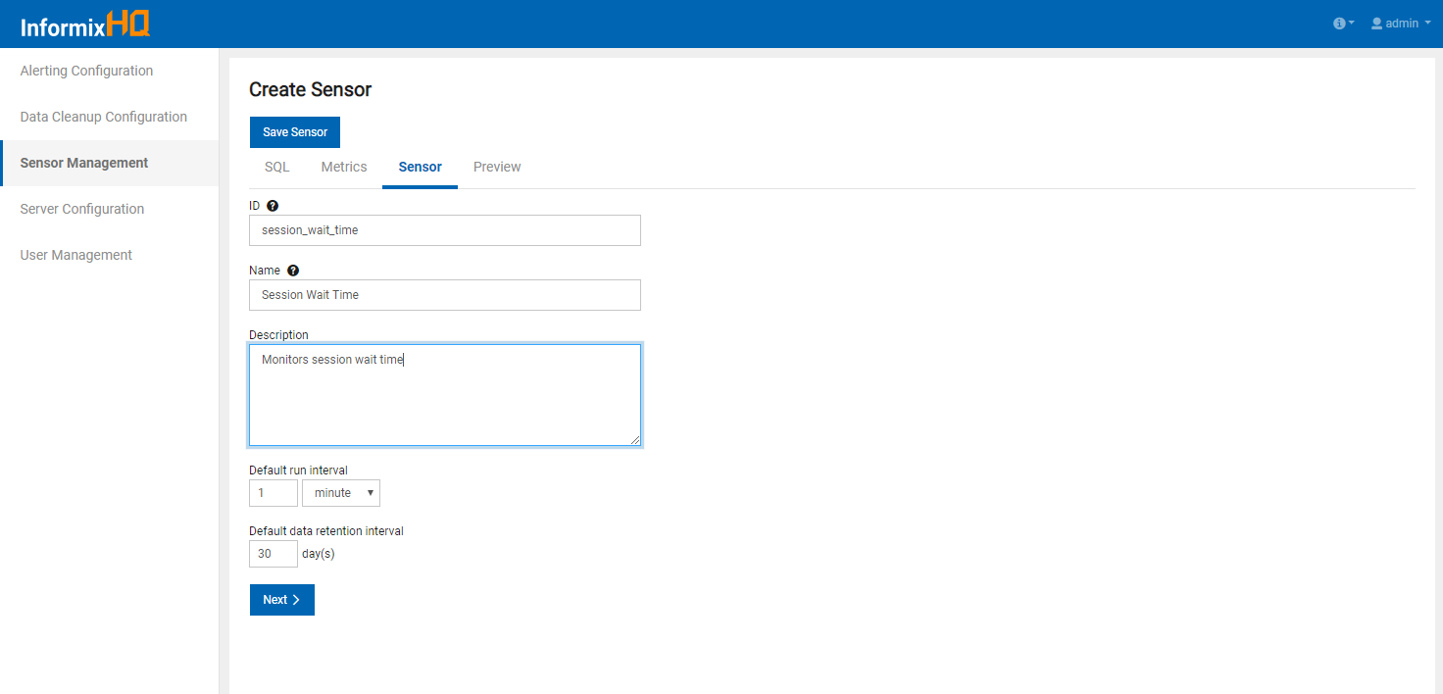

Slide 82
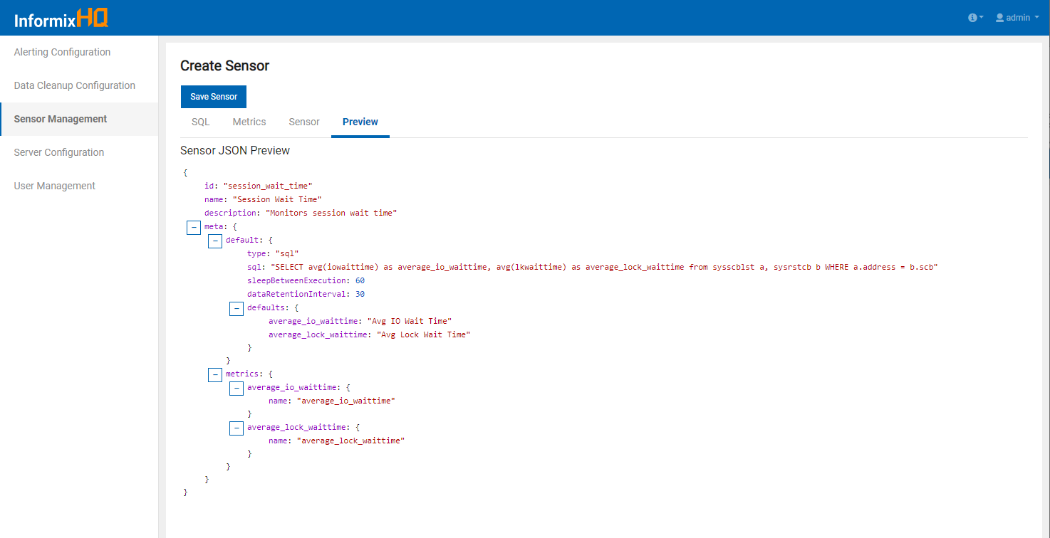
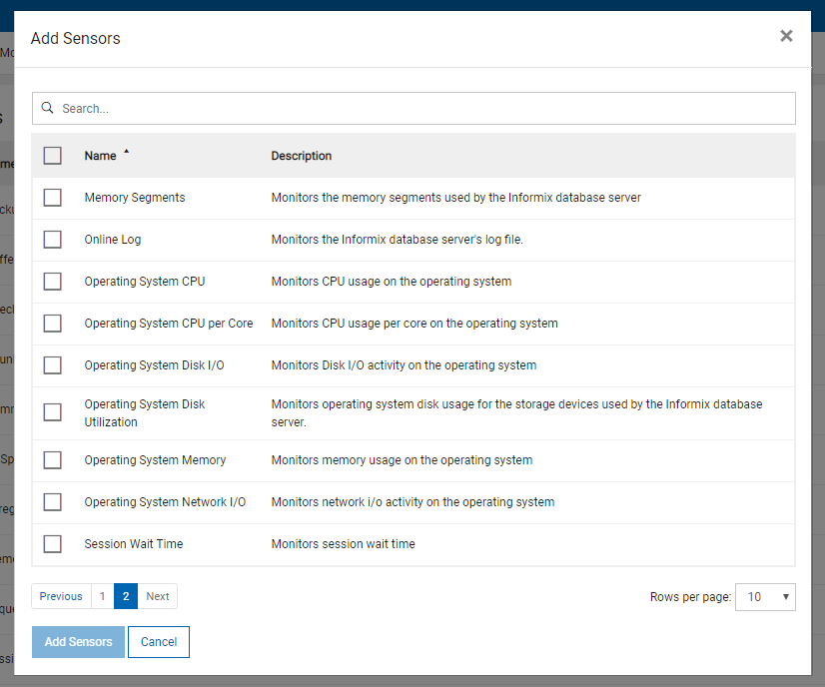

Slide 83
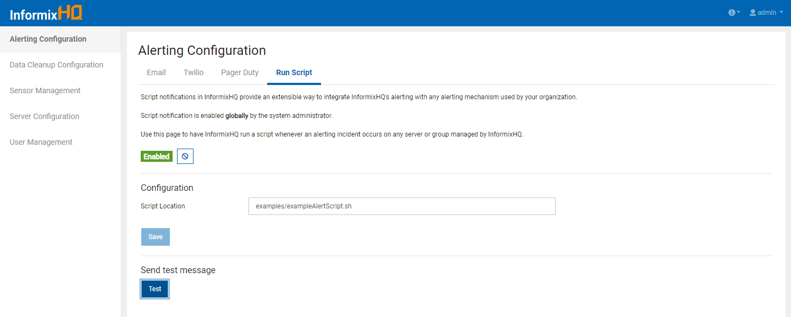
Extensible Alerting
A new extensible alerting option allows you to define a custom script to be executed whenever an alerting incident occurs

Slide 84
Extensible Alerting
When the “Run Script” alerting notification is enabled
InformixHQ server will run the specified command on the OS whenever an alerting incident occurs
Before running your script, it will set the following environment variables containing info about the alerting incident
ALERT_ID
ALERT_TIMESTAMP
ALERT_SUMMARY
ALERT_ MESSAGE
SERVER_ID
SERVER_ALIAS
GROUP_ID
GROUP_NAME
EVENT_URL

Slide 85
InformixHQ Administration – What’s New (1)
Schema Manager
Browse and view detailed info on the tables and indexes in each database
Storage > Tables and Indexes
Analyze the storage characteristics of tables and indexes in each database
Perform storage optimization actions: compress, shrink, repack, and defragment
Manage your automatic storage optimization policies
High Availability
Visualize and monitor the functioning of the entirety of your HA cluster
New agent sensors for monitoring HA status and performance
Enterprise Replication
Visualize your ER domain
Find detailed statistics about each Informix node participating in replication

Slide 86
InformixHQ Administration – What’s New (2)
Auto Update Statistics
Manage automatic update statistics policies, ensuring queries continue to run efficiently as data changes over time
Privileges
Manage database, table, & SQL Admin API level privileges, and internal users
System Reports
Full set of detailed reports on aspects of your database server's performance
Task Scheduler
Manage and customize tasks for your database server
Memory Manger
Visualize and monitor your database server's memory usage
Configure its Low Memory Manager configuration

Slide 87
InformixHQ Administration – What’s New (3)
Backups
New history timeline of your most recent database server backups

Slide 88
Schema Manager
The “SQL Console” page from version 14.10.xC1 has been expanded into a “Schema Manager” in 14.10.xC2
Schema Manager
Select a database and browse the objects in that database
Tables
Views
External tables
Collections
System Catalog Tables
View details about any table object, including…
Columns
Indexes
Constraints
Run ad-hoc SQL queries against the database
Page through query results
See query run time

Slide 89
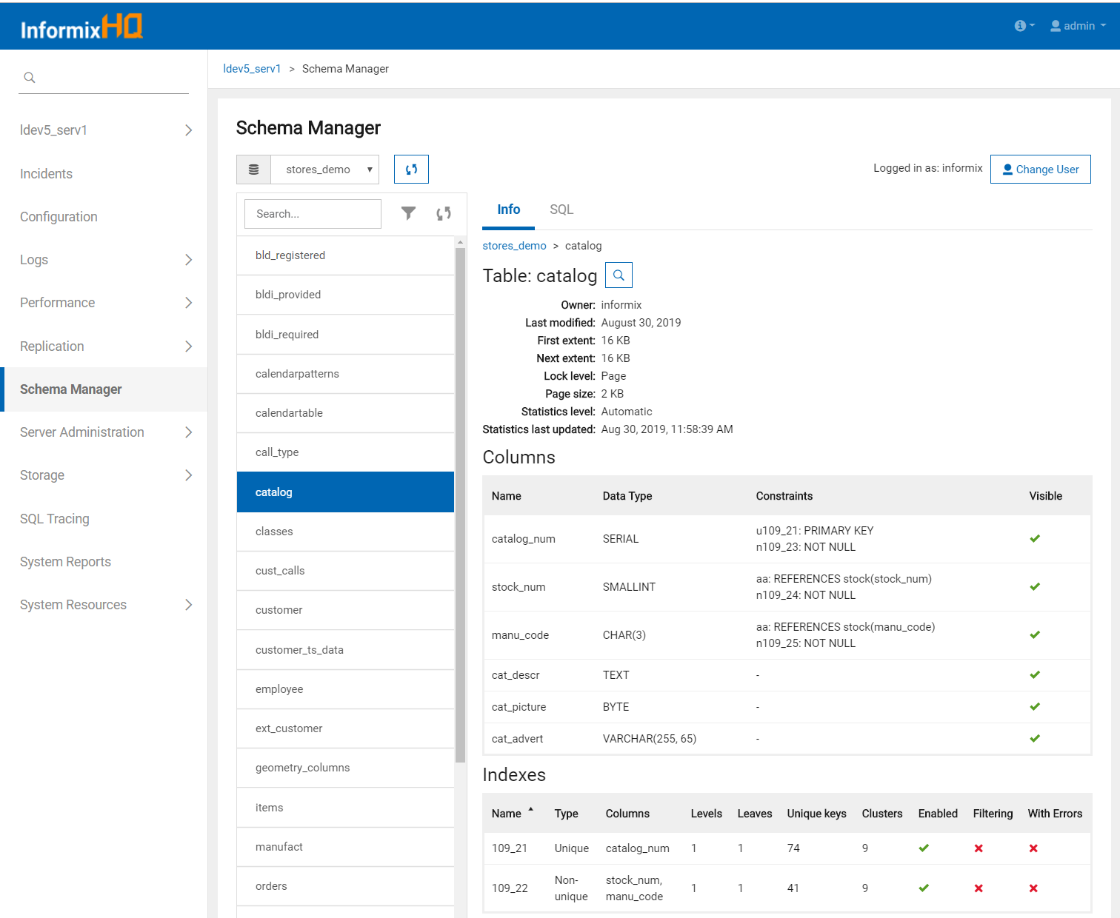

Slide 90
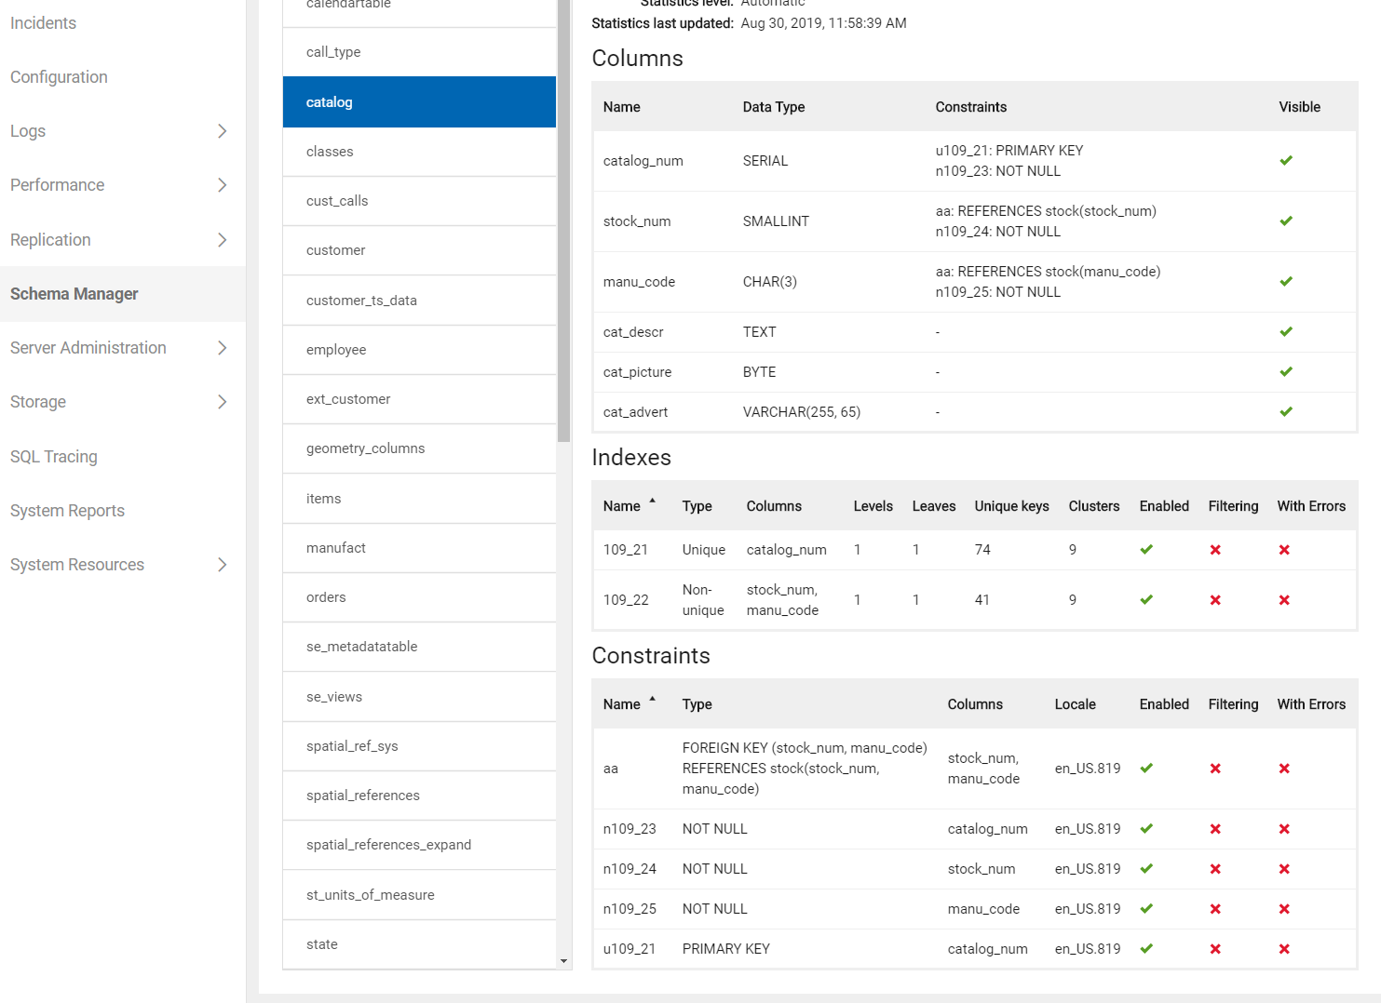

Slide 91
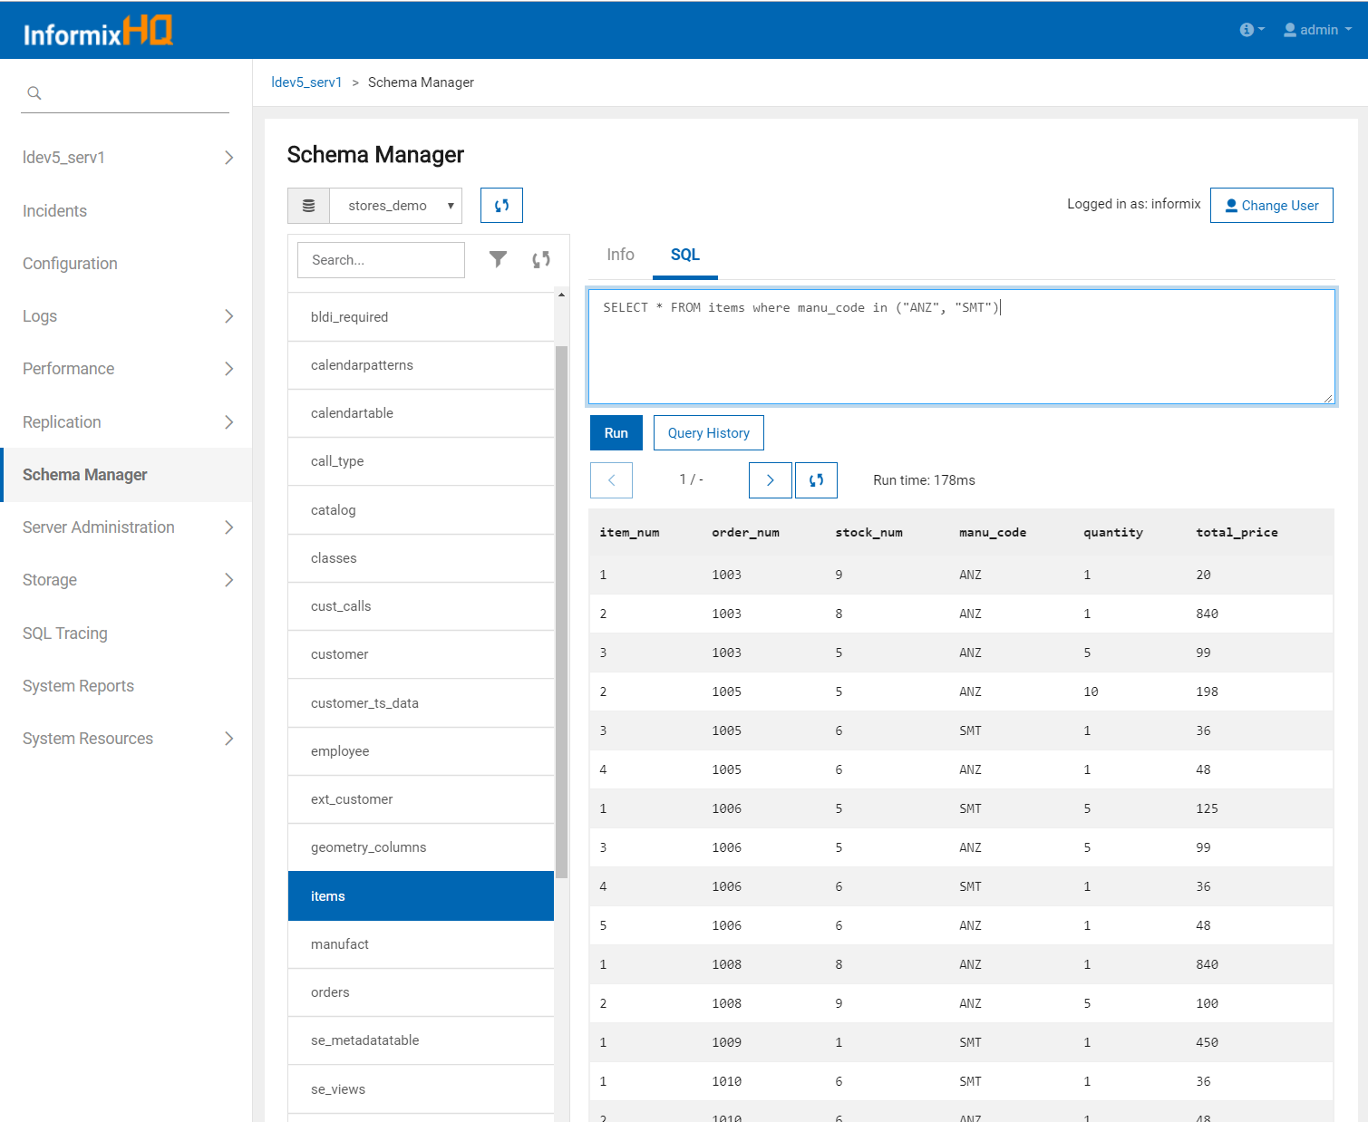

Slide 92
Storage > Tables and Indexes
Analyze the storage characteristics of the tables and indexes in each of your databases
Estimated compression savings
Page usage
Perform storage optimization actions
Compress and uncompress
Shrink
Repack
Defragment
Remove in-place alters
Manage your automatic storage optimization policies

Slide 93
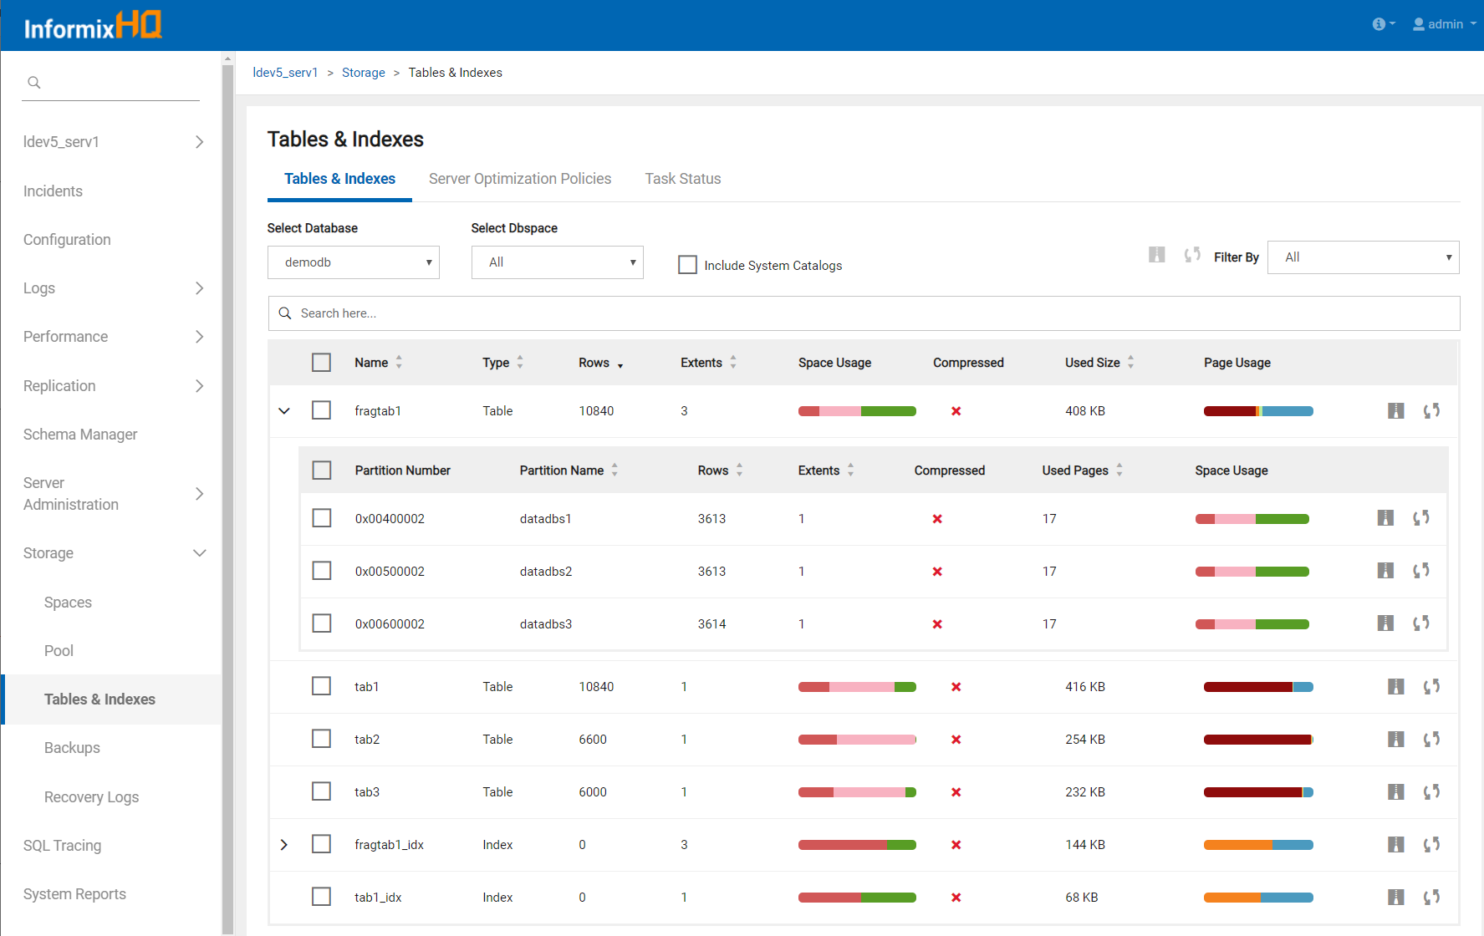

Slide 94
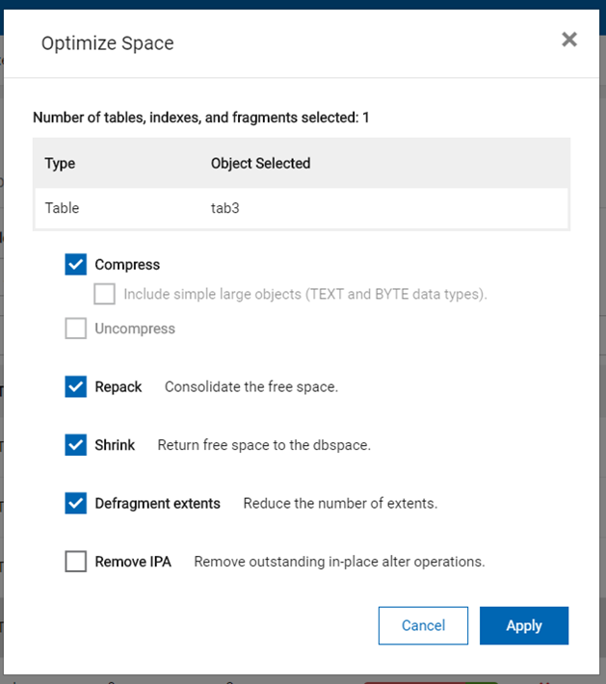
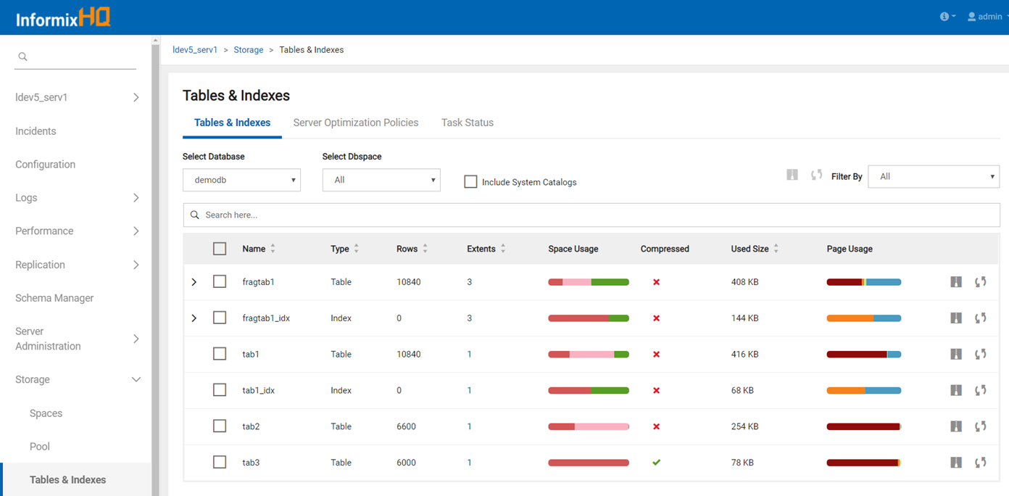
Perform storage optimization actions
Compress and uncompress
Shrink
Repack
Defragment
Remove in-place alters

Slide 95
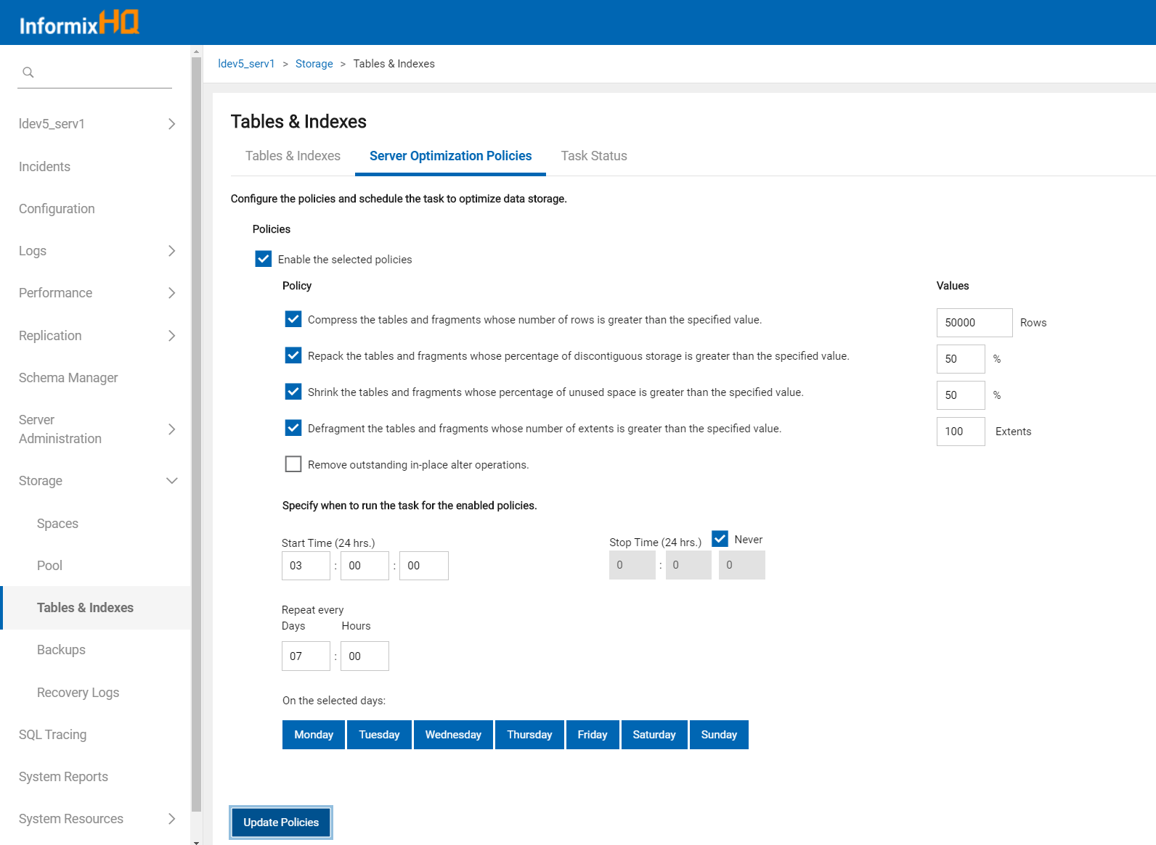

Slide 96
High Availability (1)
Visualize your high availability cluster
Cluster topology
Primary and secondary server status details
SMX status
View and edit HA onconfig parameters
Monitor the performance of your cluster
New agent sensors for monitoring HA status and performance:
HA connection status
HA CPU workload %
HA transaction latency
HA lagtime for each server in the cluster
HA logical log rate (log records processed per second)
HA log backlog

Slide 97
High Availability (2)
View the history of these metrics graphically in the UI
Can also configure alerts on any of these metrics

Slide 98
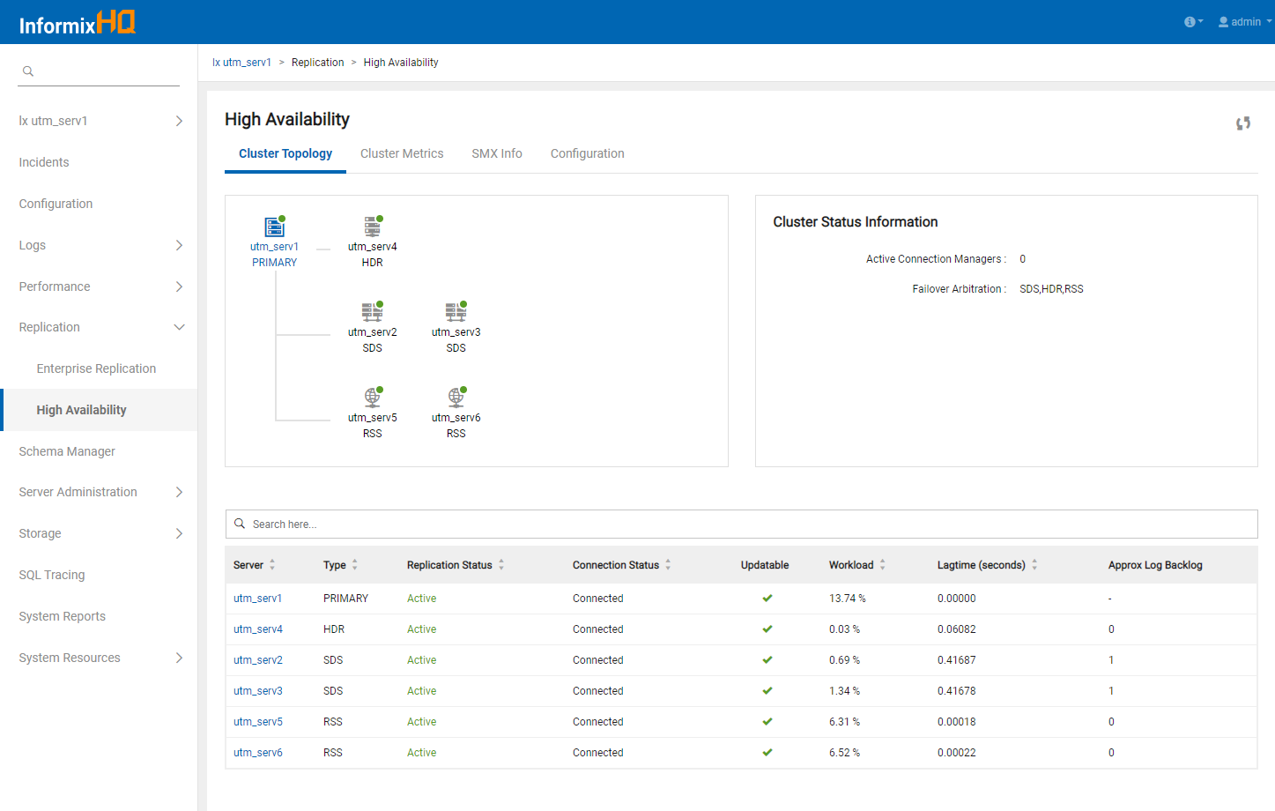

Slide 99
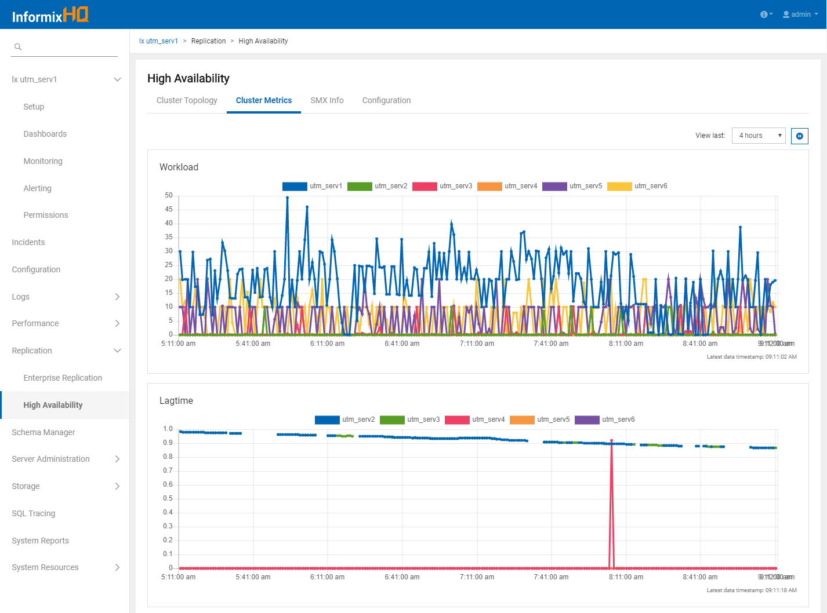

Slide 100
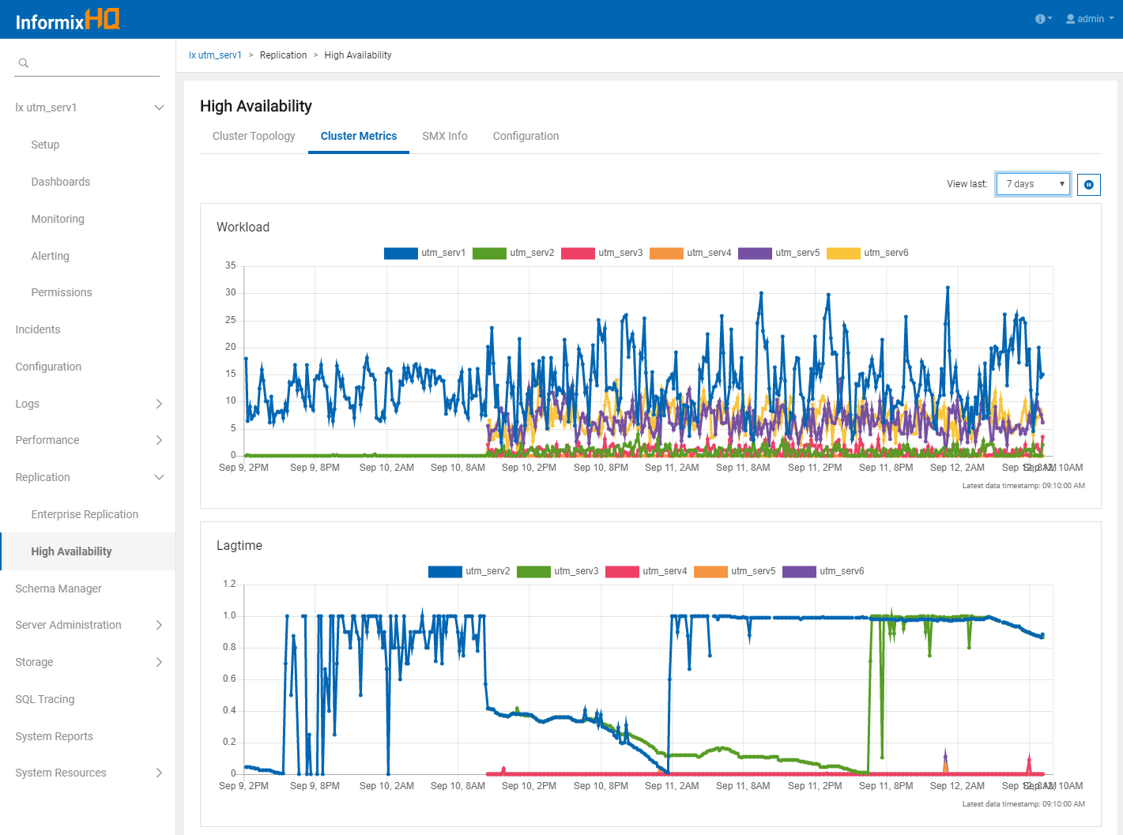

Slide 101
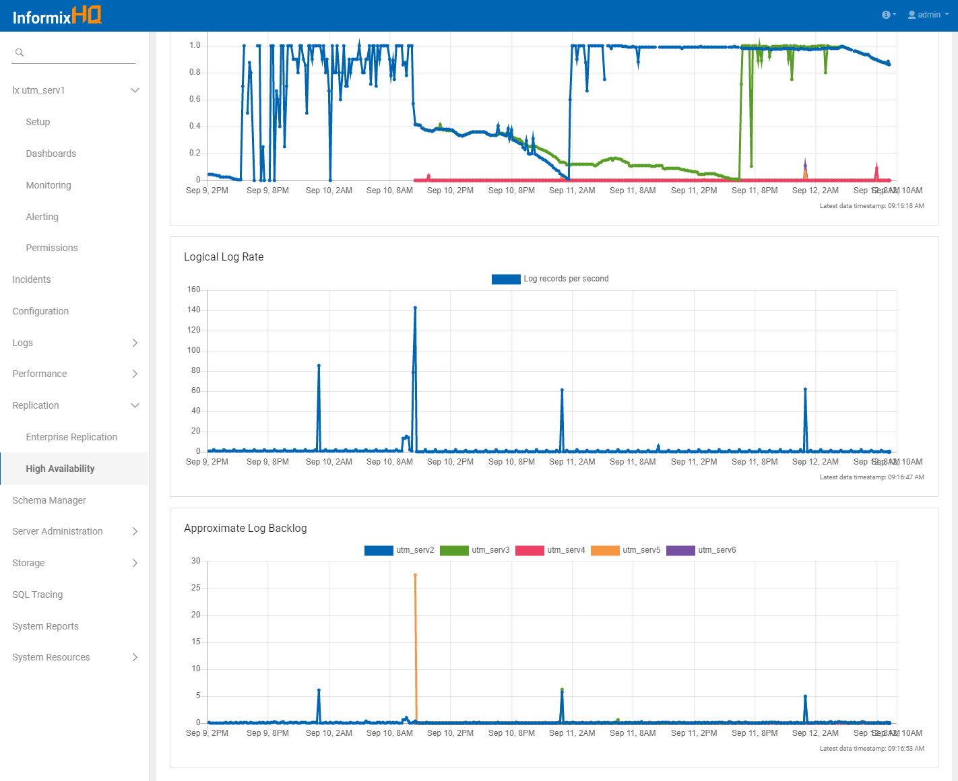

Slide 102
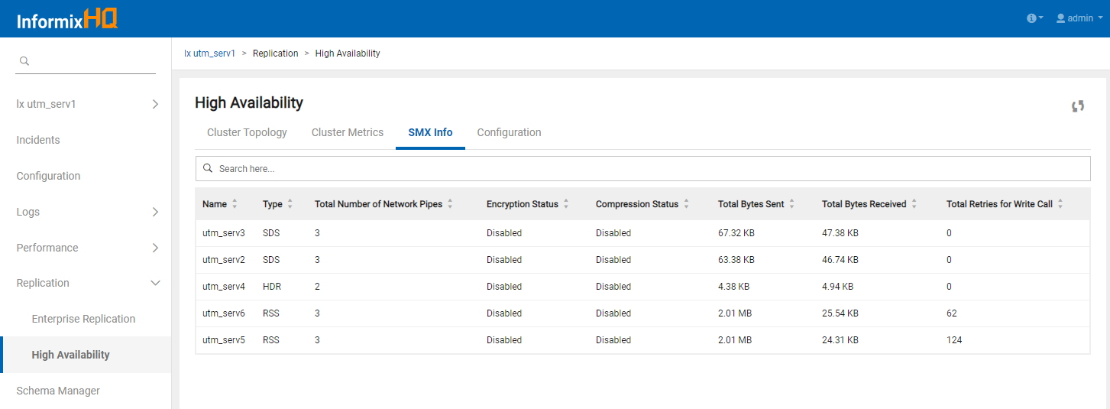
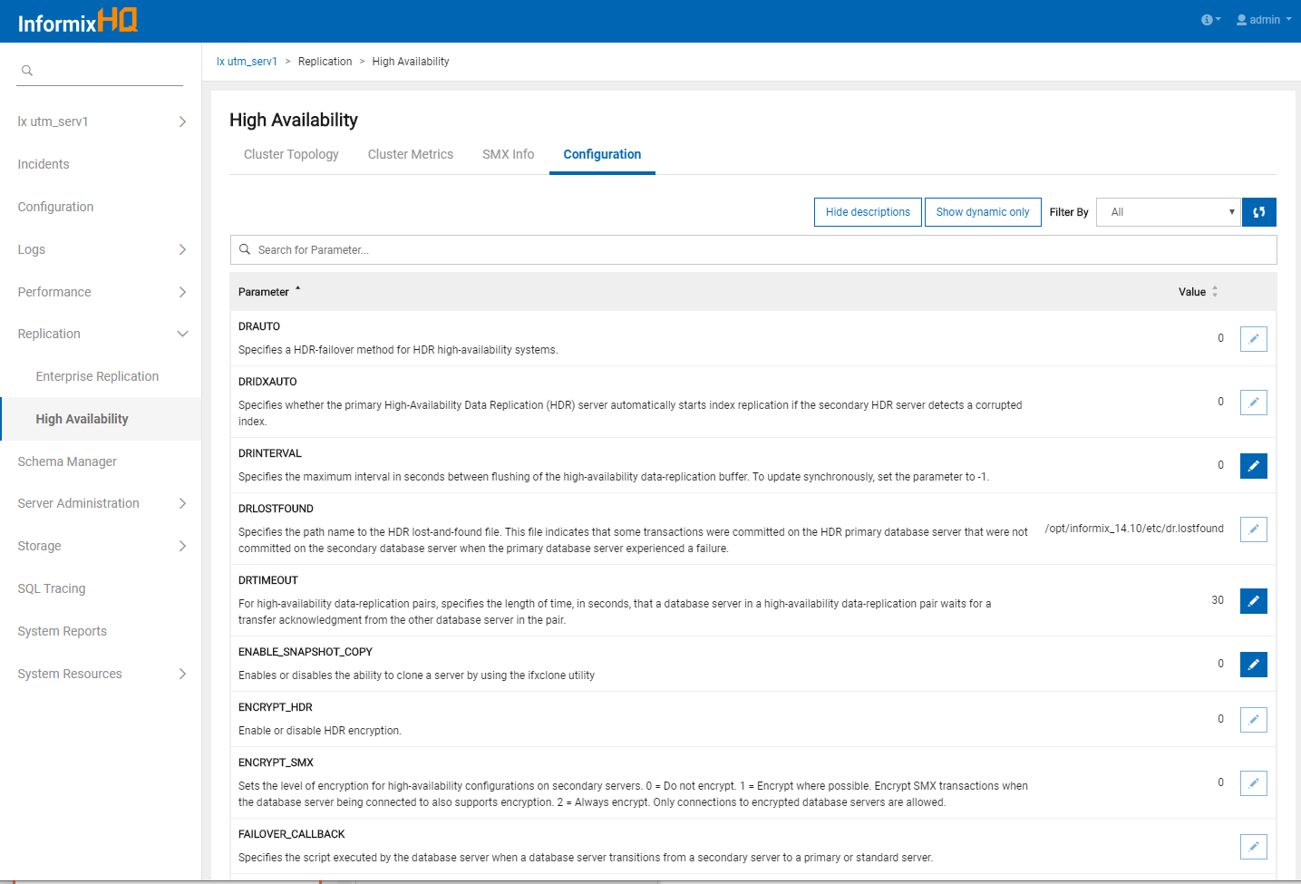

Slide 103
Enterprise Replication
Visualize the topology of your ER domain
ER node list
Member servers (stand-alone vs. cluster)
Node type (root, non-root, leaf)
Server version
ER node statistics
Capture, apply, and network status
Number of connection nodes
Pages until block
Spooled and pending transactions
Disk usage
Average latency
Fail rate
ATS/RIS file count

Slide 104
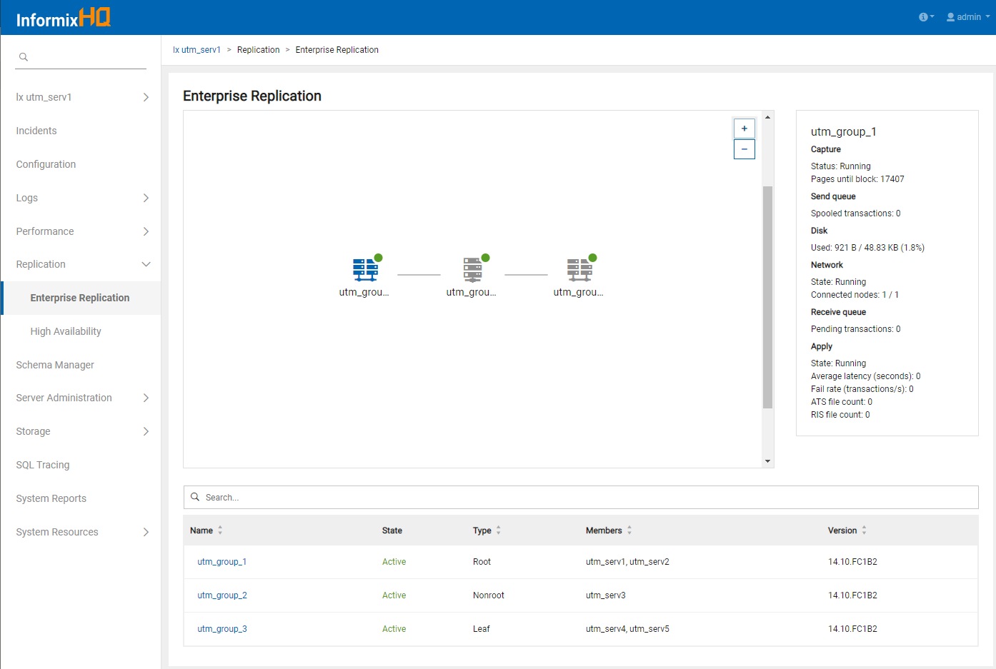

Slide 105
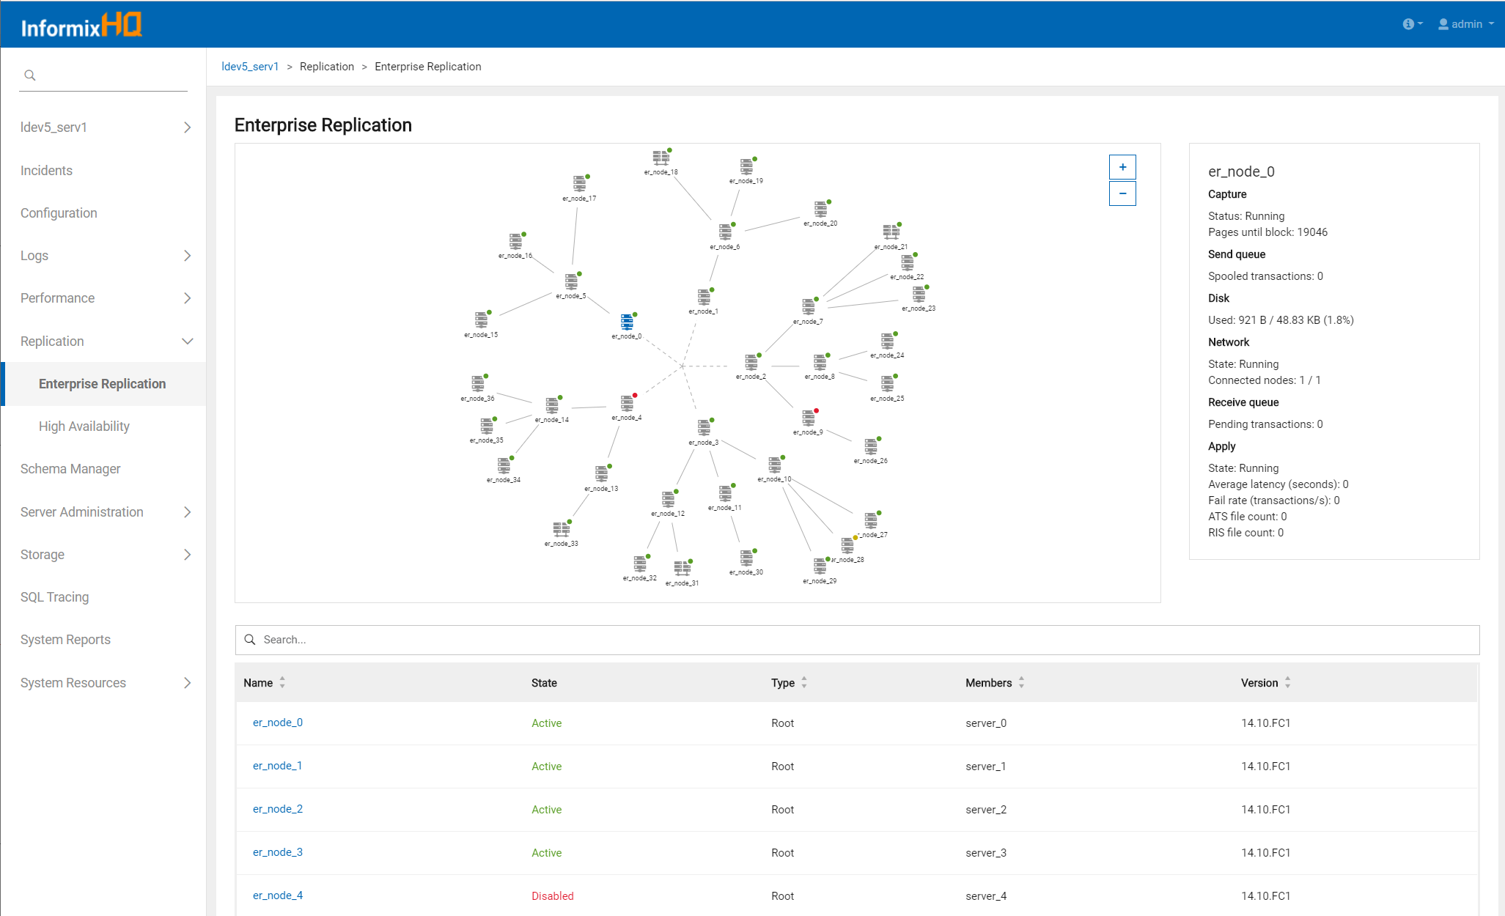

Slide 106
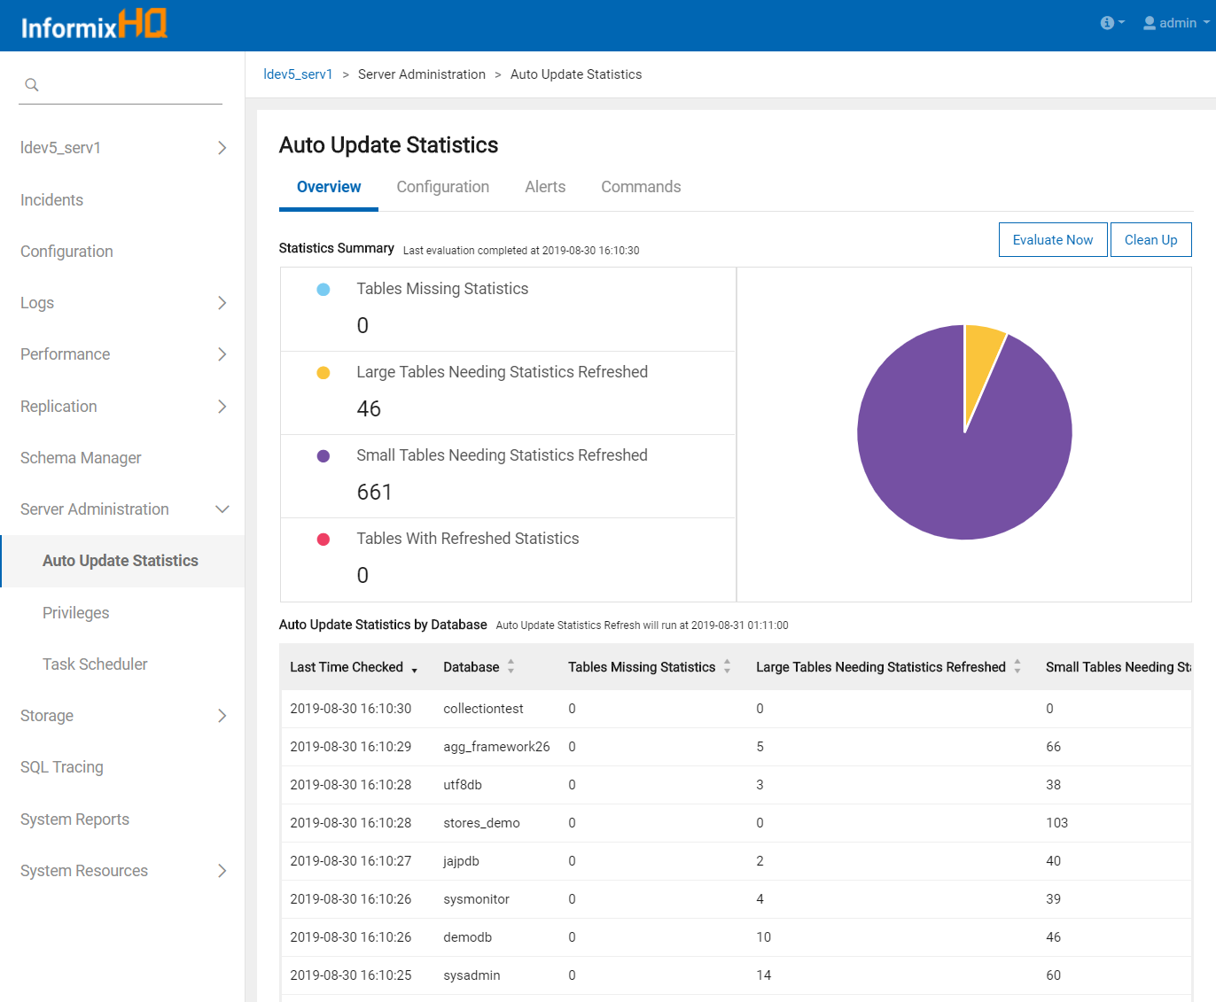
Auto Update Statistics
Manage your automatic update statistics policies, ensuring your queries continue to run efficiently as your data changes over time

Slide 107
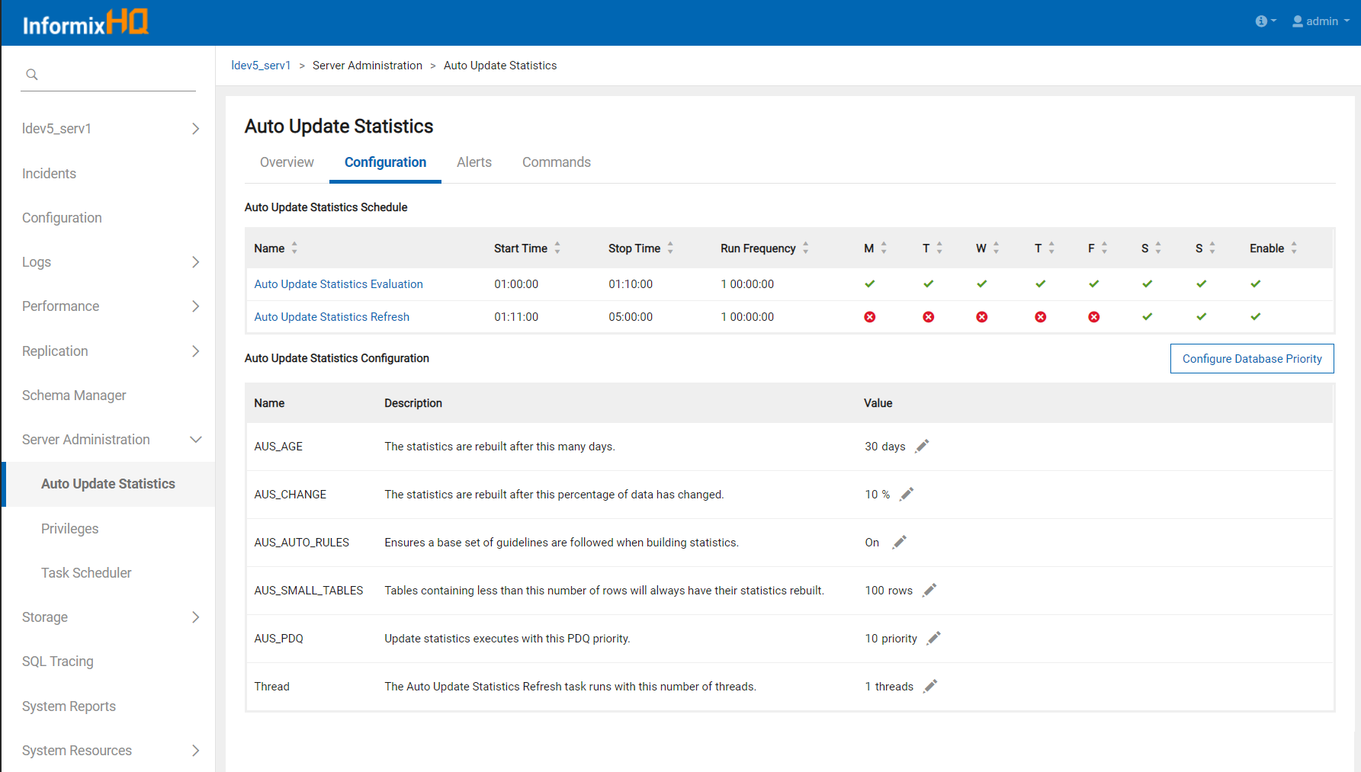
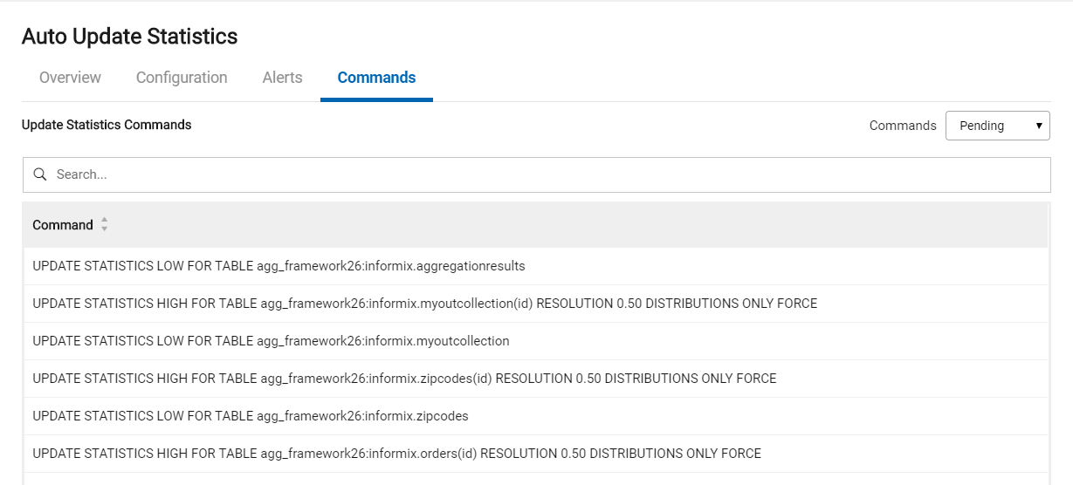

Slide 108
Privileges
View and manage privileges on your database server
Database level privileges
Table level privileges
SQL Admin API privileges
Internal users (mapped users)

Slide 109
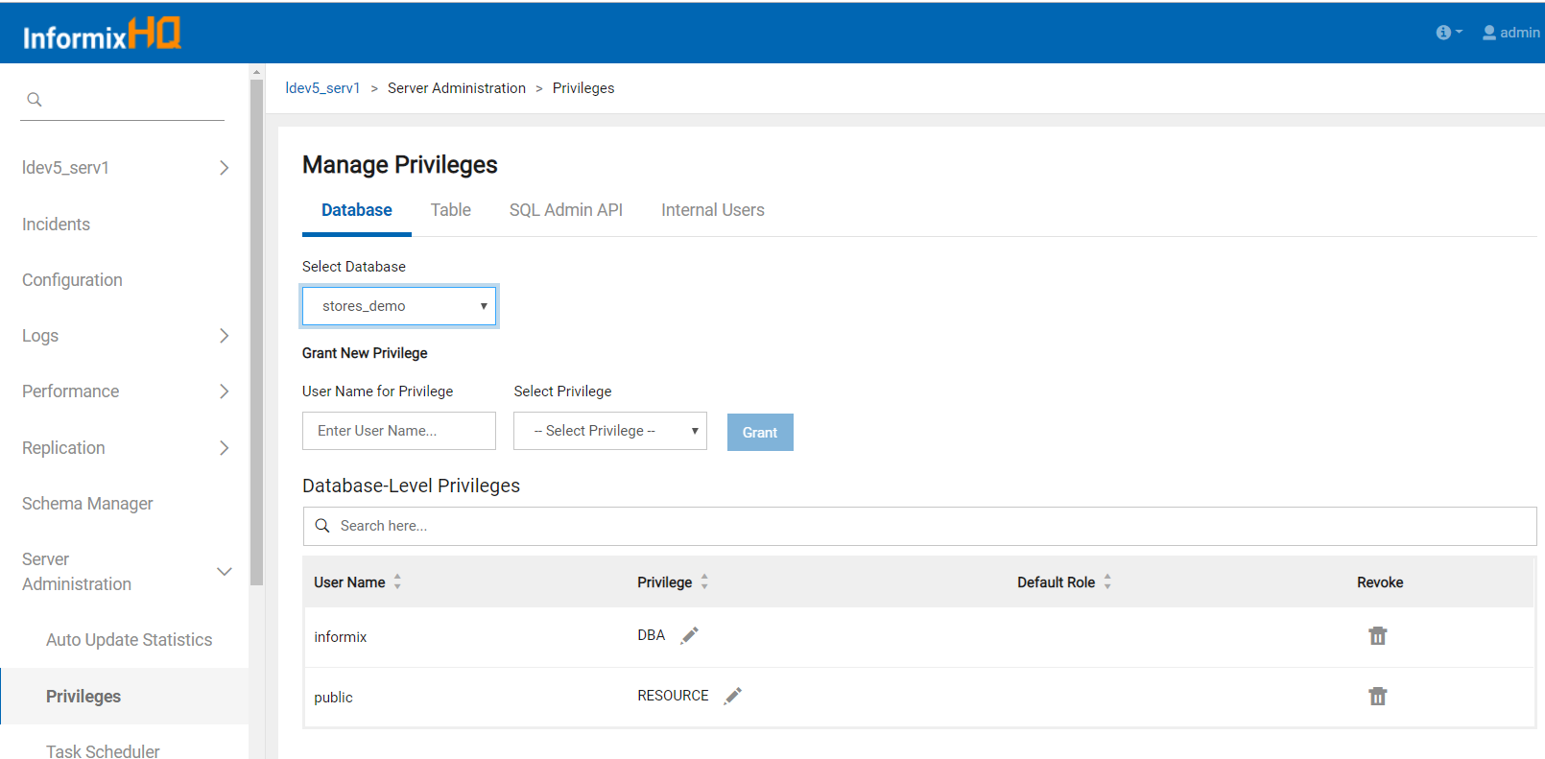
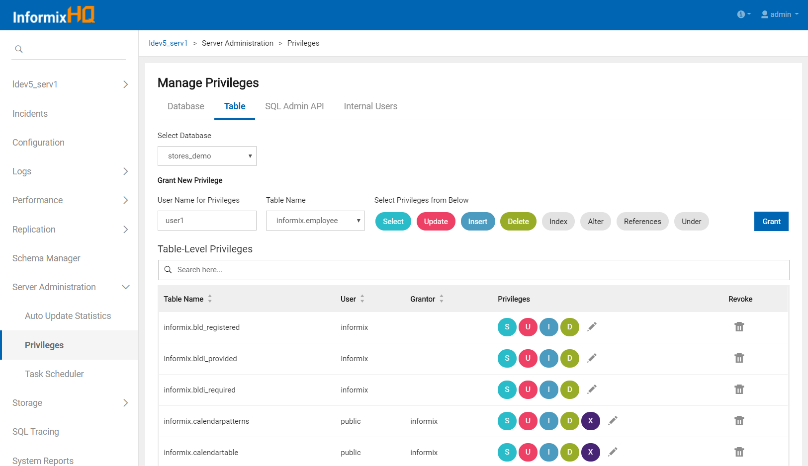

Slide 110
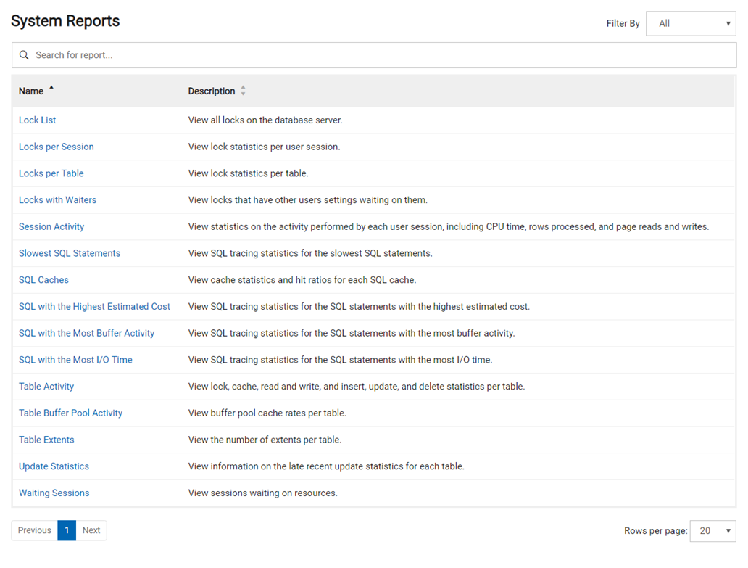
System Reports
Details reports on aspects of your database server's performance

Slide 111
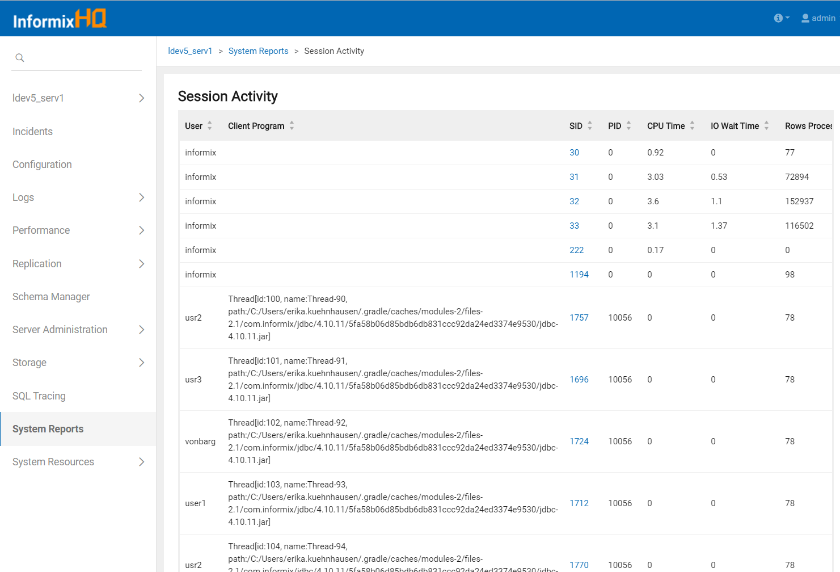

Slide 112
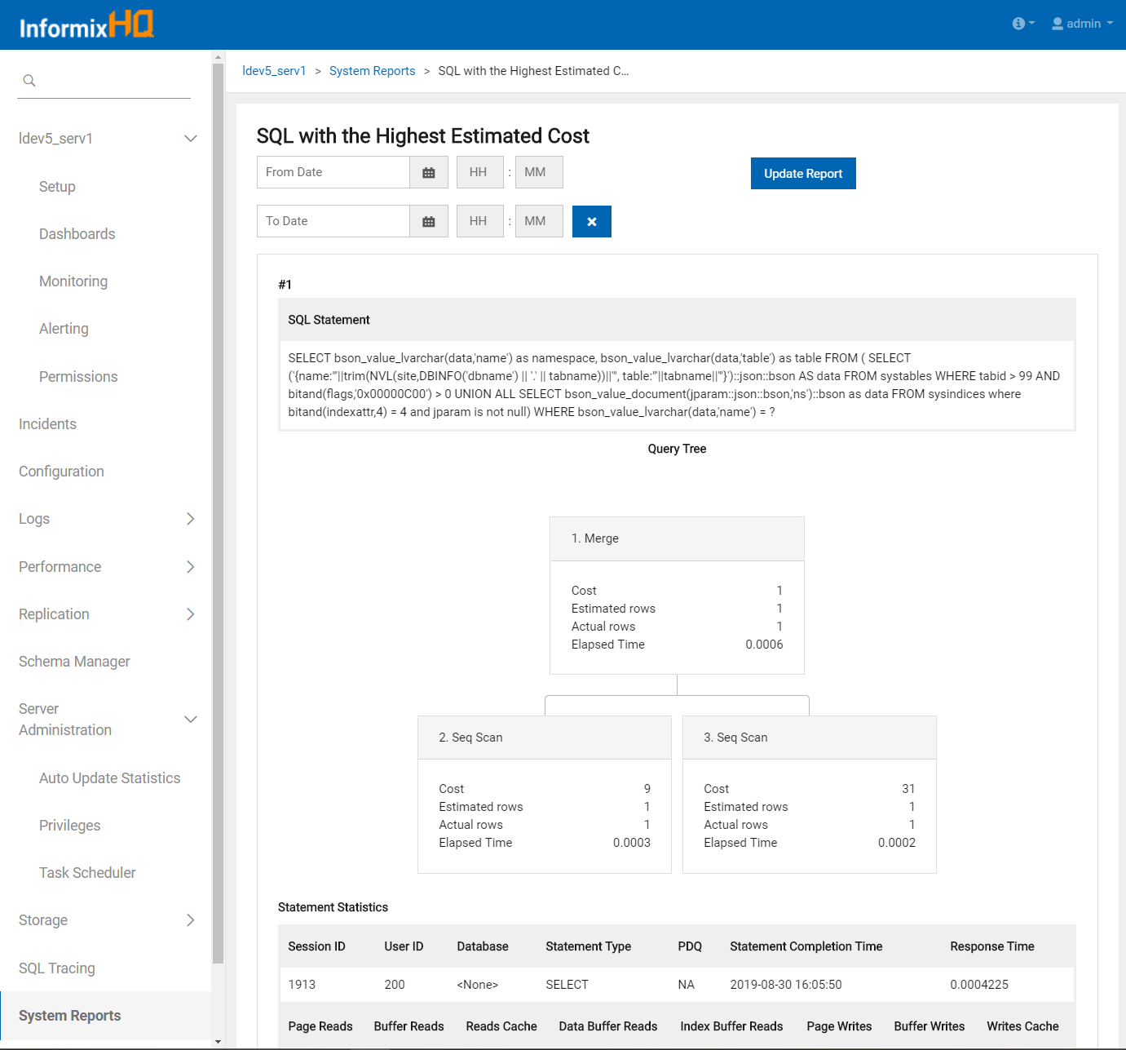

Slide 113
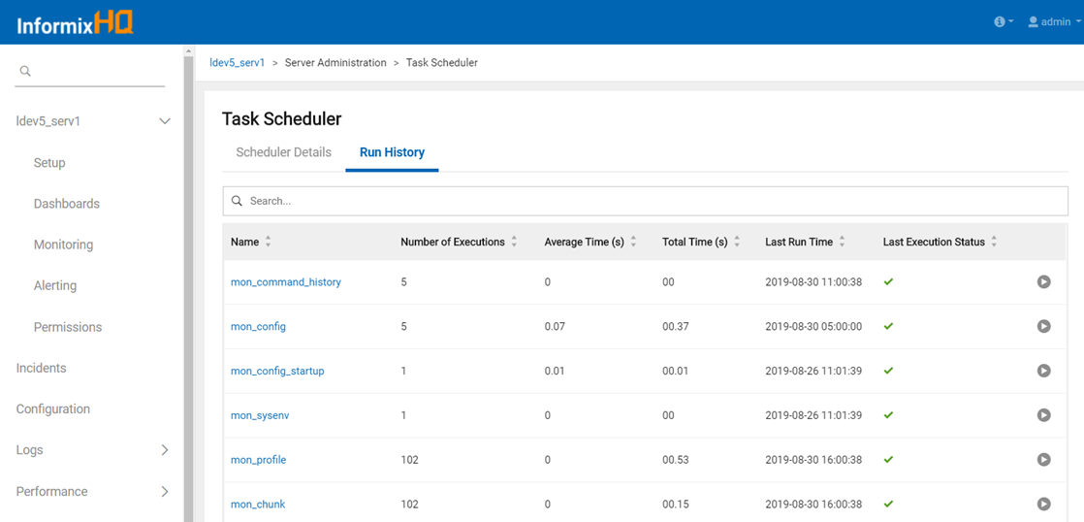
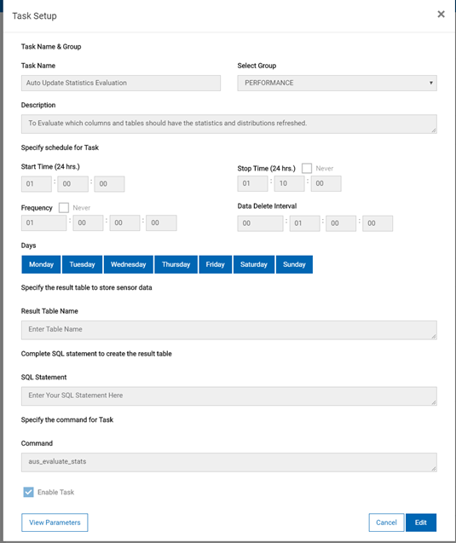
Task Scheduler
Manage and customize sysadmin tasks for your database server
Ad-hoc task executions

Slide 114
Task Scheduler

Slide 115
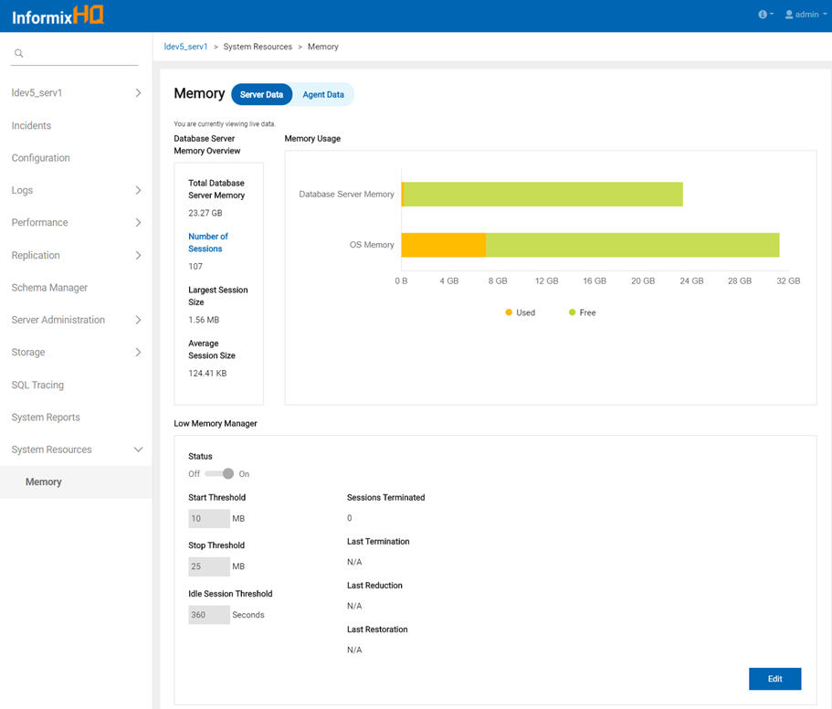
Memory Manager
Visualize and monitor your database server's memory usage
Configure its Low Memory Manager configuration

Slide 116
Backups
New history timeline of your most recent database server backups
Previously supported:
View backup status
Configure regular backups
Run ad-hoc backups
View backup logs

Slide 117
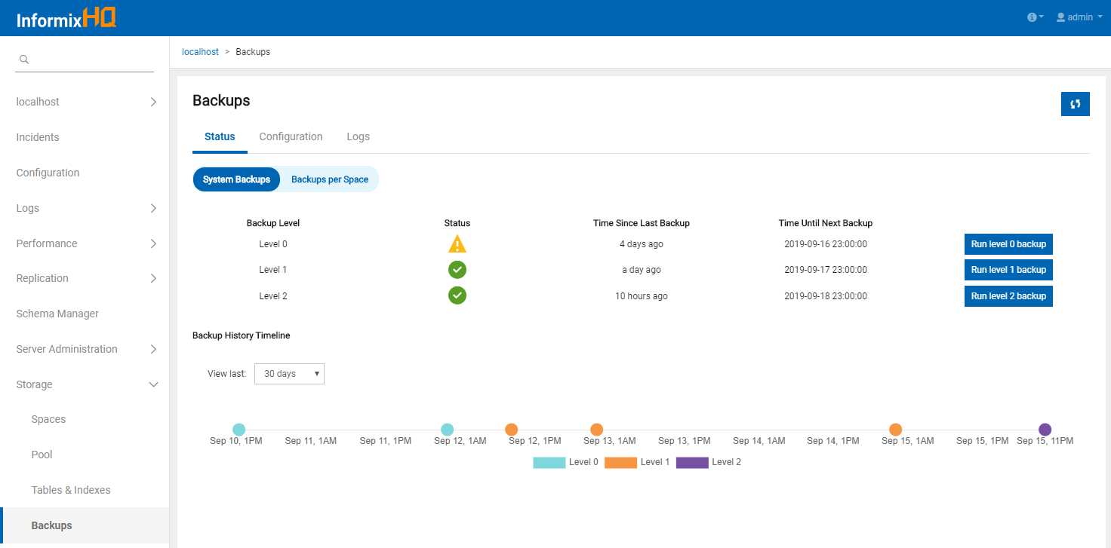

Slide 118
Usability Enhancements
Centralized user permission management
View and manage the entirety of a user's permissions within InformixHQ in a single place.
Group incidents page
View all of the alerting incidents that occurred on an entire group of Informix servers from one centralized page
New logging framework
Logback logging framework
Allows for a better out of the box logging experience
Provides enhanced options for logging customization

Slide 119
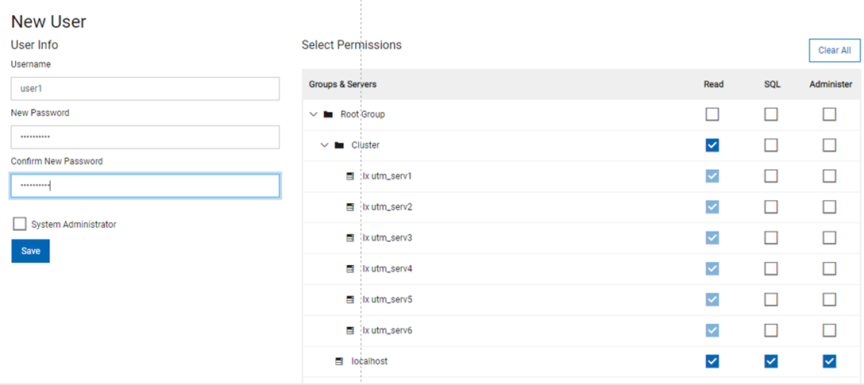
Centralized User Permission Management
View and manage all of a user's permissions within InformixHQ in a single place.

Slide 120
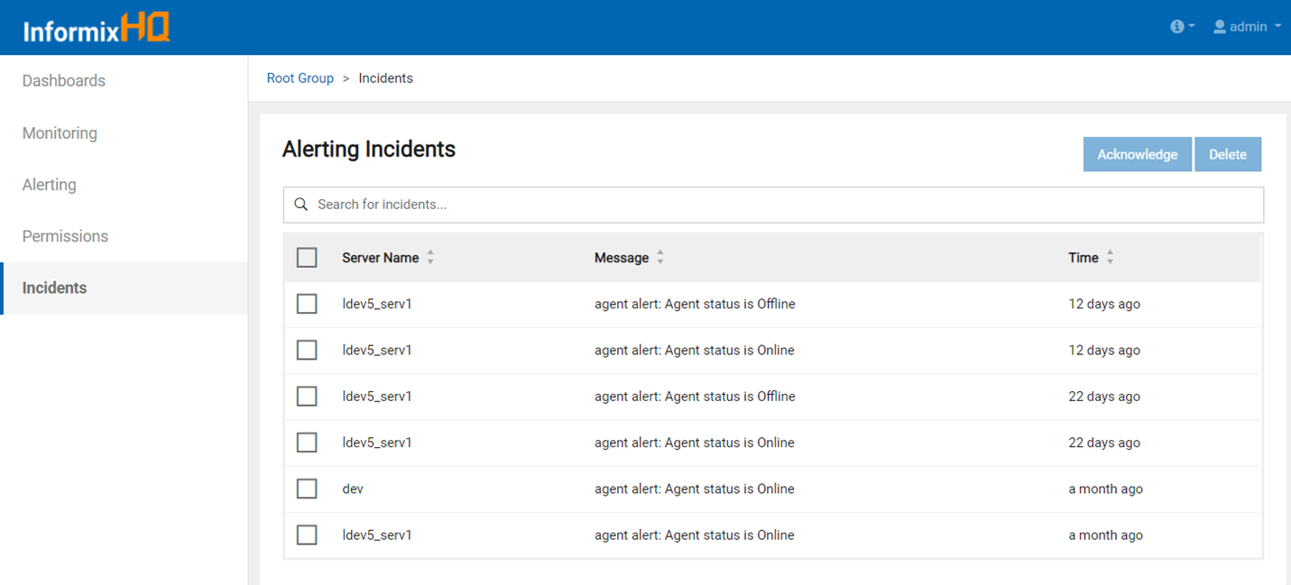
Group Incidents Page
View all alerting incidents occurring on an entire Informix server group from one centralized page

Slide 121
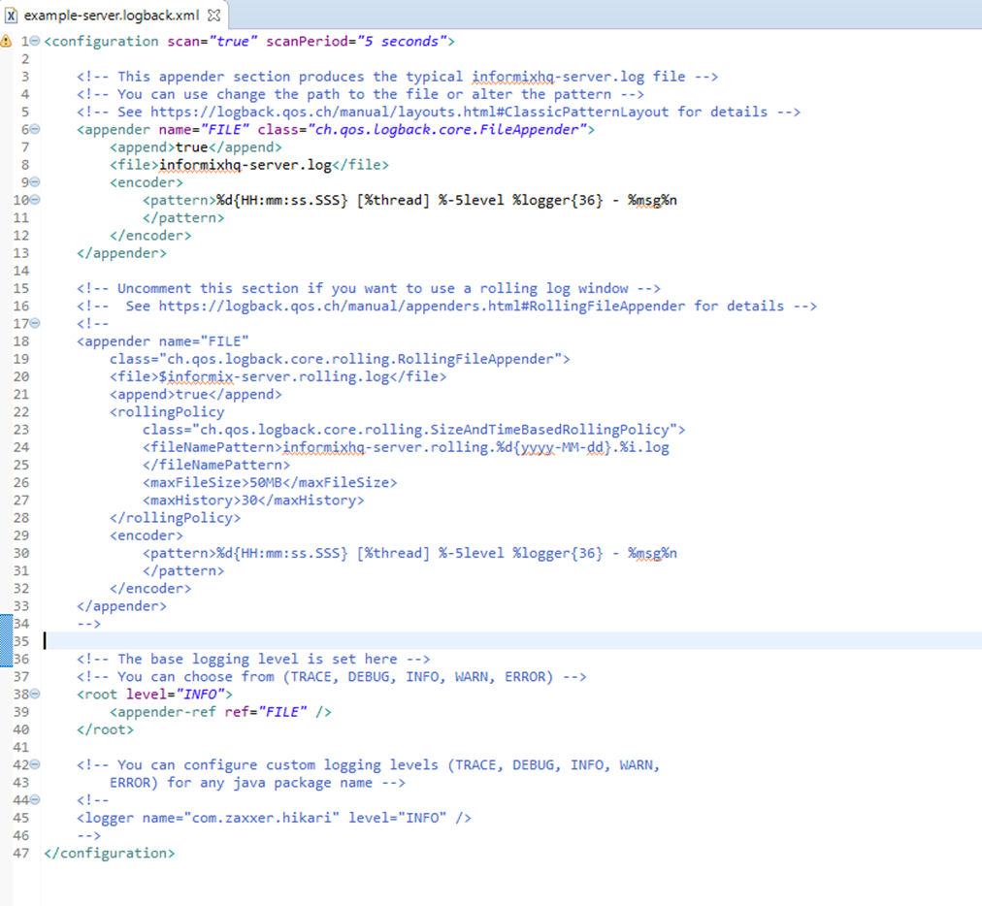
New Logging Framework: Logback
Logback logging framework
Allows for a better out of the box logging experience
Provides enhanced options for logging customization

Slide 122
Questions

Slide 123
Kandoo ERP

Slide 124
Warning!

Slide 125
IF you don’t love or believe in Informix technology
OR you are convinced that pain, stress then severe anemia are mandatory conditions to be rewarded for your work
OR you accept the idea that fair trade, skills sharing and fun teamwork cannot compete with the market leaders’way of doing business
OR you think that imitating the crowd is the right way to run a successful business
THEN
you may leave this room until we call you back
ELSE
Just sit down and listen: we certainly have common believes that we want to tell you about
END IF

Slide 126
Wait! This never existed
in the Informix stratosphere!
Have you ever imagined:
Having full control on a complete Open Source, multi-company and multi-languages ERP suite,
Using a powerful, fully web-enabled and integration-oriented IDE at no charge,
Running on a bullet-speed Cloud or On-Premises environment
Fully tailored and optimized for Informix,
Combined with
Decision autonomy on whatever helps you to make your customers happy (i.e local sale prices, local and or functional adaptations etc…)
Benefit from collaboration and mutual help within a growing international community of truly Informix and ERP experts,
Capacity for this community to address projects you never dreamed about
Resulting in
Awesome competitivity on sales, cost and maintenance prices
More than fair financial reward for your work effort
Becoming (if you want) a share-holder of a soon visible software company

Slide 127
No more dreams: just reality!
KandooERP fulfills all those requirements!

Slide 128
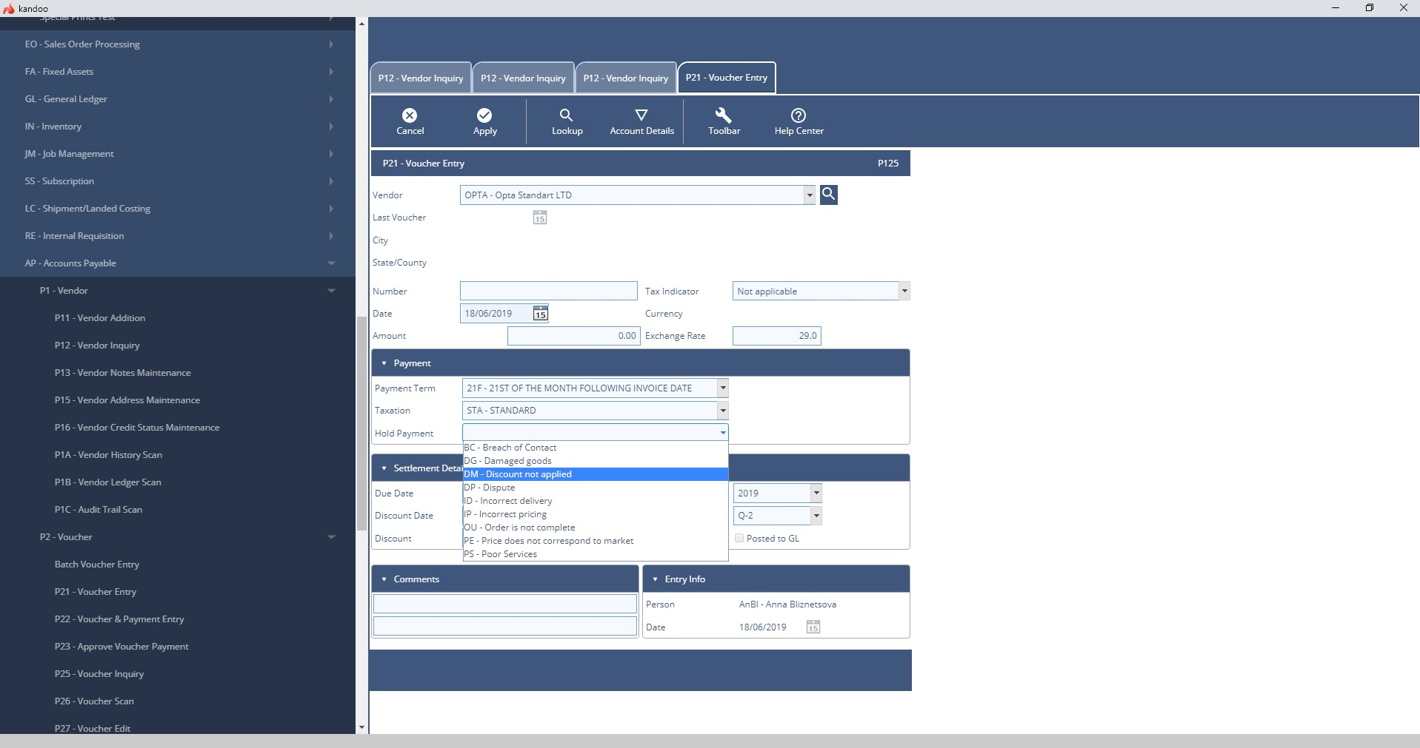
What can KandooERP do?
Multi-company, Multi-lingual & Multicurrency with consolidating accounts,
Multi-warehouse.
Modular covering all aspects of Accounting, Manufacturing , Orders Management, Human Resources, Subscriptions etc.
Fully Analytical
Fully extensible

Slide 129
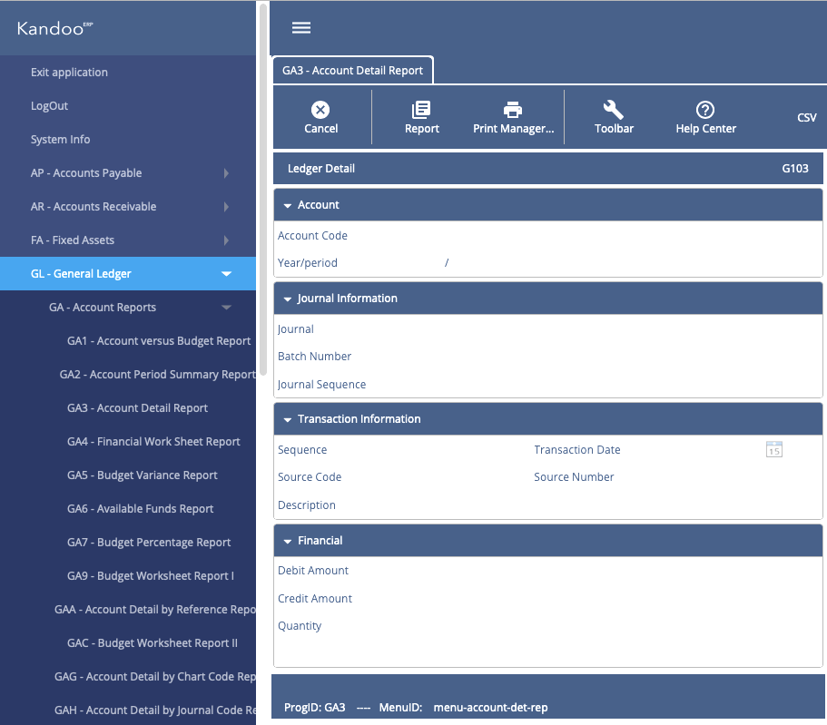
Who is Kandoo ERP for?
Small & Medium Business
Large & Very Large Business
On cloud or on-premises

Slide 130
Why are companies reluctant to adopt a ‘Big ERP solution’ ?
More and more companies are not satisfied with major ERP solutions (SAP,Oracle etc…)
Their software license and maintenance prices are absurdly high,
Integrators labour cost is very high:
But their technical and functional skills, as well as experience levels do not always meet expectations
Integrators often come with solutions before listening to the customer
Service contract amendments list nevers ends ➔ implementation is generally several years behind schedule,
Implementation is generally X (X>2) times over budget,
A too high proportion of those projects just fail after a few years
Customer does not own the source code of his implementation:
This generates a strong but undesired dependence on the software vendor
Even if he is not happy with the vendor or the integrator

Slide 131
Why would companies like KandooERP?
KandooERP is Open Source:
The customer has full control on the development and who works on it (internal and/or external developers)
The customer possesses the source code
Your rates are probably more affordable than big integrators’ rates
You can adapt your prices according to local and daily reality, becoming competitive
4GL is the best language for this type of application
Customization is easier and faster than with any other Open Source language
Kandoo is a community made of real and passionate experts
You will never be left by yourself when any unexpected issue arises
We listen to the customer and apply his requirements,
Not the opposite ☺
This is a key factor for a successful implementation

Slide 132
Reasons why you want to join KandooERP
Fully Open Source code = full control of the solution and guarantee on the future
Written in 4GL
The most productive Business Application development language, despite what others say
Easy and cost effective to support and extend
IDE license free of charge = reduce development costs
Features a 4GL and Forms code generator
Modern and open architecture (truly on premises and cloud) ready for the future, fully UTF8
Great integration platform (BIRT, Java interface, REST API, Web Services, MQ messaging and more)

Slide 133
Unity is Strength
Kandoo is a worldwide growing Community
More than 20 countries involved, many languages, in 4 continents
Our shared passion are the 4GL language and happy customers
Our group holds centuries/man of technical and business experience and knowledge
DBAs, developers, project managers, ERP specialists …
All willing to share, cooperation is our bonding cement
With Kandoo scoreboard system, you can contribute in many different ways and cumulate benefits:
Member referral, translate messages, design new functionality, donate vertical app, enhance implementation, bring new customer ….
Kandoo can be your main or additional source of income, according to your investment in the community and the time you will dedicate
The only pressure you will receive is your customer’s pressure, not ours

Slide 134
Kandoo ERP Road Map
Grow the installed base
Keep growing the community
Extend functionality by adding vertical markets
Tackle major ERP vendors by making kandooERP compatible with their software
Become a significant INFORMIX Business Partner

Slide 135
Stop Thinking: Come With Us And Take Your Share!
Visit us ASAP at www.kandooerp.org
Ask us any question by email at info@kandooerp.org
Try our demo on cloud at demo.kandooerp.org
Register as a Kandoo member to have access to all your free development resources, application documentation etc
And above all
HAVE FUN

Slide 136
Questions

Slide 137
Legal Disclaimer
© IBM Corporation 2015. All Rights Reserved.
The information contained in this publication is provided for informational purposes only. While efforts were made to verify the completeness and accuracy of the information contained in this publication, it is provided AS IS without warranty of any kind, express or implied. In addition, this information is based on IBM’s current product plans and strategy, which are subject to change by IBM without notice. IBM shall not be responsible for any damages arising out of the use of, or otherwise related to, this publication or any other materials. Nothing contained in this publication is intended to, nor shall have the effect of, creating any warranties or representations from IBM or its suppliers or licensors, or altering the terms and conditions of the applicable license agreement governing the use of IBM software.
References in this presentation to IBM products, programs, or services do not imply that they will be available in all countries in which IBM operates. Product release dates and/or capabilities referenced in this presentation may change at any time at IBM’s sole discretion based on market opportunities or other factors, and are not intended to be a commitment to future product or feature availability in any way. Nothing contained in these materials is intended to, nor shall have the effect of, stating or implying that any activities undertaken by you will result in any specific sales, revenue growth or other results.
If the text contains performance statistics or references to benchmarks, insert the following language; otherwise delete: Performance is based on measurements and projections using standard IBM benchmarks in a controlled environment. The actual throughput or performance that any user will experience will vary depending upon many factors, including considerations such as the amount of multiprogramming in the user's job stream, the I/O configuration, the storage configuration, and the workload processed. Therefore, no assurance can be given that an individual user will achieve results similar to those stated here.
If the text includes any customer examples, please confirm we have prior written approval from such customer and insert the following language; otherwise delete: All customer examples described are presented as illustrations of how those customers have used IBM products and the results they may have achieved. Actual environmental costs and performance characteristics may vary by customer.
Please review text for proper trademark attribution of IBM products. At first use, each product name must be the full name and include appropriate trademark symbols (e.g., IBM Lotus® Sametime® Unyte™). Subsequent references can drop “IBM” but should include the proper branding (e.g., Lotus Sametime Gateway, or WebSphere Application Server). Please refer to http://www.ibm.com/legal/copytrade.shtml for guidance on which trademarks require the ® or ™ symbol. Do not use abbreviations for IBM product names in your presentation. All product names must be used as adjectives rather than nouns. Please list all of the trademarks that you use in your presentation as follows; delete any not included in your presentation. IBM, the IBM logo, Lotus, Lotus Notes, Notes, Domino, Quickr, Sametime, WebSphere, UC2, PartnerWorld and Lotusphere are trademarks of International Business Machines Corporation in the United States, other countries, or both. Unyte is a trademark of WebDialogs, Inc., in the United States, other countries, or both.
If you reference Adobe® in the text, please mark the first use and include the following; otherwise delete: Adobe, the Adobe logo, PostScript, and the PostScript logo are either registered trademarks or trademarks of Adobe Systems Incorporated in the United States, and/or other countries.
If you reference Java™ in the text, please mark the first use and include the following; otherwise delete: Java and all Java-based trademarks and logos are trademarks or registered trademarks of Oracle and/or its affiliates.
If you reference Microsoft® and/or Windows® in the text, please mark the first use and include the following, as applicable; otherwise delete: Microsoft and Windows are trademarks of Microsoft Corporation in the United States, other countries, or both.
If you reference Intel® and/or any of the following Intel products in the text, please mark the first use and include those that you use as follows; otherwise delete: Intel, Intel Centrino, Celeron, Intel Xeon, Intel SpeedStep, Itanium, and Pentium are trademarks or registered trademarks of Intel Corporation or its subsidiaries in the United States and other countries.
If you reference UNIX® in the text, please mark the first use and include the following; otherwise delete: UNIX is a registered trademark of The Open Group in the United States and other countries.
If you reference Linux® in your presentation, please mark the first use and include the following; otherwise delete: Linux is a registered trademark of Linus Torvalds in the United States, other countries, or both. Other company, product, or service names may be trademarks or service marks of others.
If the text/graphics include screenshots, no actual IBM employee names may be used (even your own), if your screenshots include fictitious company names (e.g., Renovations, Zeta Bank, Acme) please update and insert the following; otherwise delete: All references to [insert fictitious company name] refer to a fictitious company and are used for illustration purposes only.

Slide 138
Thank You!

